Slide 1

mooDSpHERE
An Emotion Based Music Recommender

Slide 2
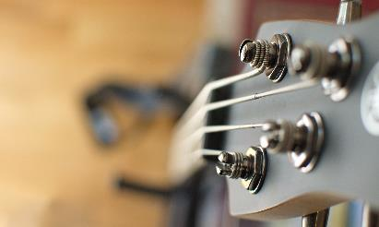


Agenda
Team Member Roles and Responsibilities
Improvements made from Professor Feedback
Project Description
Team-Work Agreement
Personas
MVP
Technologies
Algorithms
Diagrams
Sprint 3 Recap
Product Backlog
Sprint Summary (Sprint 2 + Sprint 3)
Sprint 4 Backlog
Metrics
Retrospective
Project Demo - Sprint 4 (current sprint)
GitHub link
Live Application Demo

Slide 3


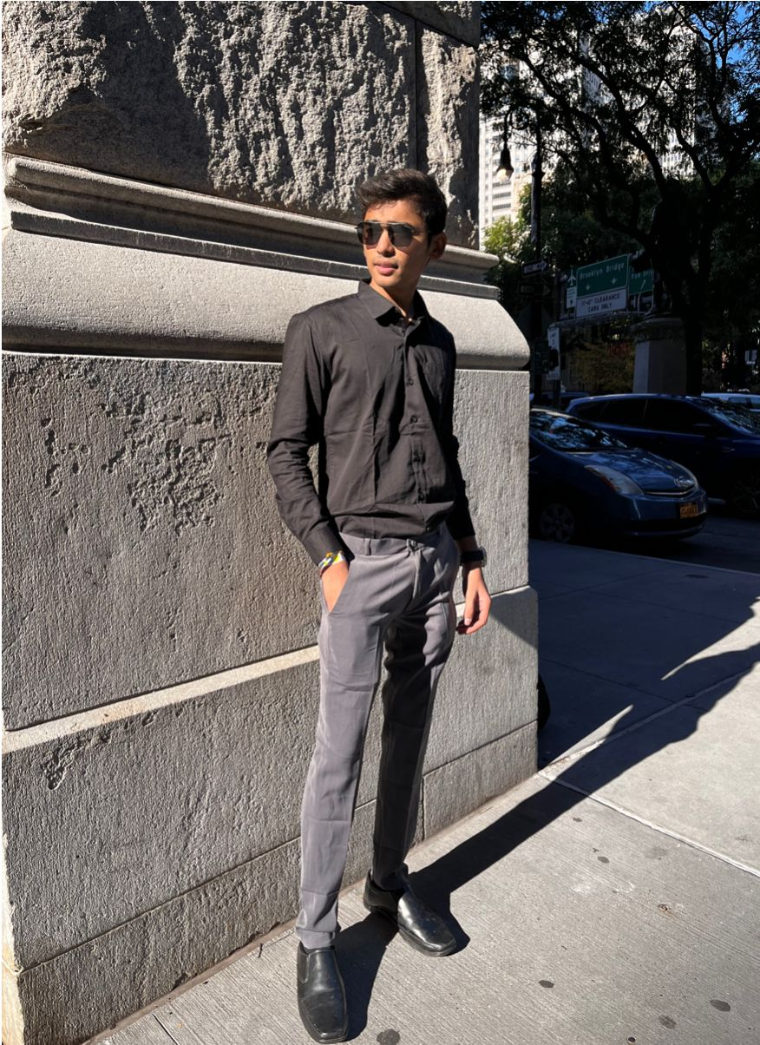

team
Bhavik Chopra
Dhyey Dave
Krushil Sheladiya
Mahesh Nakka
Data Scientist
Lead Developer
UI/UX Developer
Backend developer/QA

Slide 4




team
Nisarg Bhuva
Shane Parmar
Urmil Trivedi
Vijay Devkate
Scrum Master/QA
Backend Developer/Product Owner
Architect/Developer
ML Engineer/ UI Designer

Slide 5





IMPROVEMENTS FROM FEEDBACK, changes And additions
Added Sprint Summary(Sprint 2 + sprint 3)(Slide 43-51)
Added Assignee in Product Backlog(Slide 37-42)
Updated Sprint 4 Test Cases(Slide 55-57)
Updated Stories Sprint 4 Completed and Not Completed(Slide 58-62)
Added Sprint 4 Backlog(Slide 52-54)
Updated Metrics(Slide 63-80)
Updated Application Screenshots(Slide 85-97)
Updated APIs(Slide 98-105)
This symbol represents the Improvements, Changes or Additions made.

Slide 6
Project Description
Project Name: | MoodSphere
Team: | DevDynasty
Project Description: | Using facial expression detection techniques and machine learning algorithms in real time to understand the user's mood. for the music enthusiasts seeking a personalized and emotionally resonant listening experience, who wants to listen to their music based on their current emotional state the MoodSphere is an application that takes out the hassle of going through all the options in traditional music applications to hear the right music for their mood, that employs facial recognition and CNNs to analyze your real-time emotional expressions captured through the camera. unlike traditional music recommendation systems solely relying on user preferences, MoodSphere distinguishes itself by incorporating facial emotion analysis. our application dynamically adjusts music recommendations as your emotional expressions evolve allowing users to experience enhanced recommendations within the application.

Slide 7
Problem statement
Conventional music streaming services frequently rely on general recommendation algorithms that ignore emotional relevance, which leaves users' emotional demands unmet. The Emotion-Based Music Recommender using Facial Recognition and Convolutional Neural Networks (CNN) project aims to combine state-of-the-art computer vision techniques in order to address this. The system uses CNNs and facial recognition technologies to accurately assess users' facial expressions for emotional indicators. The goal of this integration of sophisticated machine learning algorithms with visual data is to provide consumers with individualized music recommendations that are in line with their current emotional states, improving their listening experience as a whole.

Slide 8


tEAM-WORK AGREEMENT

Slide 9
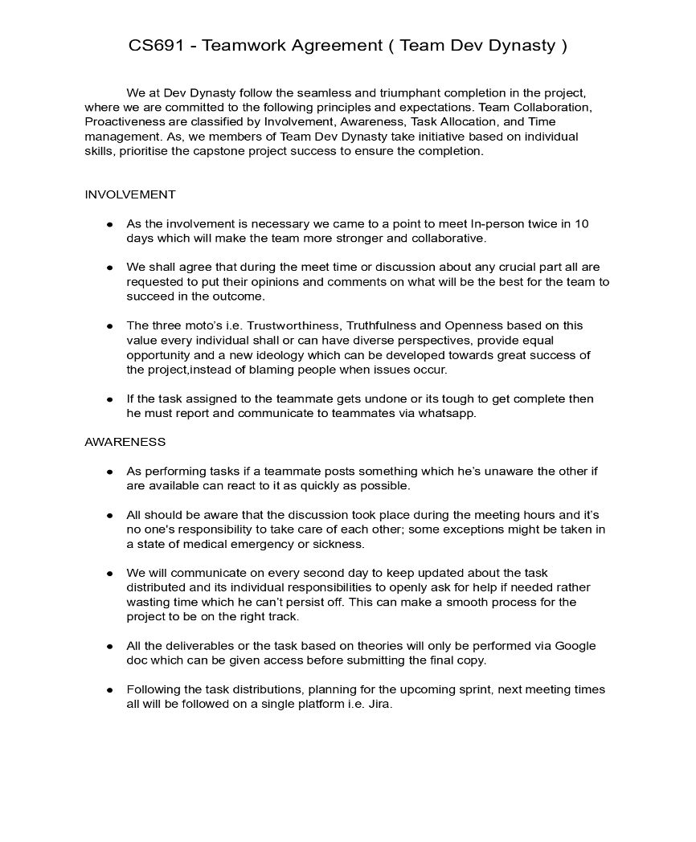
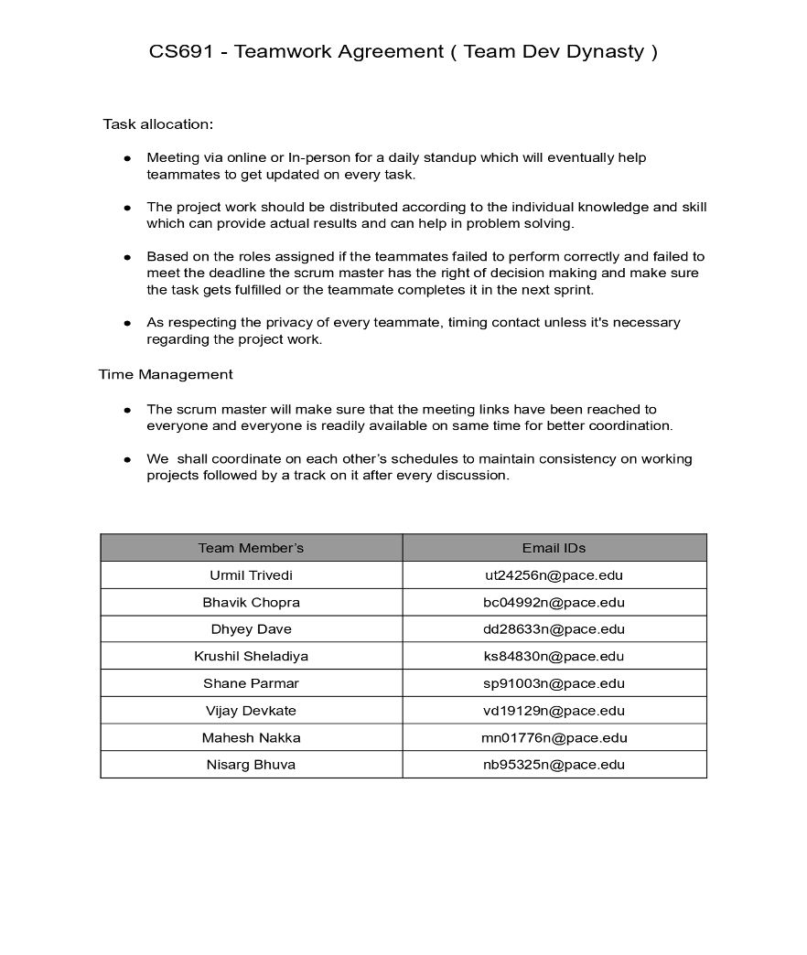

Slide 10
personas

Slide 11

PERSONA 1
Background:
Elena is a 32-year-old project manager in a tech company, often under high stress and pressure of completing project to deliver best outcomes.
Emotional Profile:
Given her high-stress role, Elena values an app that can detect subtle shifts in her mood through her interactions — be it the pace at which she scrolls or the time of day — and adjust the music without her needing to manually search for tracks. This anticipates her needs and saves time, allowing her to remain focused on her work or relaxation.
Elena
Technical Project Manager
Preferred Genres:
Classical for relaxation, soft rock for mood uplift, ambient for focus.
Interests:
Yoga, meditation, and wellness podcasts.

Slide 12

PERSONA 2
Background:
Max is a 27-year-old fitness trainer reliant on energetic music during workouts to stay energized and motivated.
Emotional Profile:
Seeks dynamic, high-tempo music for workouts and calming tunes for cooldowns. The app would suggest serene and tranquil music, aiding in the transition from high activity to relaxation. The app could potentially measure the duration of the workout to time the cooldown music perfectly.
Max:
The Energetic Fitness Enthusiast
Preferred Genres:
Upbeat EDM for workouts, soft instrumentals for cooldowns.
Interests:
High-intensity interval training, marathons, and sports nutrition.
MoodSphere

Slide 13

PERSONA 3
Background:
Lia is a 20-year-old freelance writer who works from home on content on client’s demand
Emotional Profile:
Her choice of music transcends mere background ambience, acting as a vital catalyst for her focus and creativity. It's this profound relationship with music that not only entertains but also significantly nurtures her artistic expression and emotional health. Each melody plays a specific role in her day, meticulously chosen to align with her feelings, thereby transforming her workspace into a sanctuary for inspiration and emotional balance.
Lia:
Remote Worker
Preferred Genres:
Lo-fi hip hop, smooth jazz, and classical.
Interests:
Creative writing, reading, and interior design.
MoodSphere

Slide 14

PERSONA 4
Background:
Sam is a 35-year-old commuter who has long commutes and uses music to mentally prepare or unwind
Emotional Profile:
Sam needs energizing music in the morning and relaxing music in the evening.
Sam also seeks music that can serve as a personal soundtrack to the rhythm of the city during his commutes, providing a sense of connection and vitality. In moments of stress or fatigue, he looks for tracks that can offer solace and a mental escape, helping to rejuvenate his spirit.
Sam:
The Commuter
Preferred Genres:
Pop and indie for energy, acoustic for relaxation.
Interests:
Travel podcasts, audiobooks, and city walking tours.
MoodSphere

Slide 15

PERSONA 5
Background:
Zara is a 22-year-old culinary student who enjoys cooking with music which makes her mood calm and focused.
Emotional Profile:
Zara seeks music that matches the energy of her cooking sessions
Zara enjoys music that keeps her kitchen lively and her mind sharp while she cooks. She also likes songs that go well with the different kinds of food she makes, making her cooking feel more special.
Zara:
An Aspiring Chef
Preferred Genres:
Upbeat Latin for cooking, classical for baking.
Interests:
World cuisines, food blogging, and cooking shows.
MoodSphere

Slide 16
MINIMAL VIABLE PRODUCT(MVP)

Slide 17
MINIMUM VIABLE PRODUCT
Web application with user emotion prediction and song recommendation functionality.​
Allowing user to create an account in the application.​
Interactive UI to display user uploaded image.​
CNN model to predict user's emotion on image input.​
API to accept user image in request and send the model's prediction and the list of songs from static database in response.​
Server to handle the above API along with two different endpoints to send songs based on genre and artist. ​
Model and backend connection to predict emotions. ​

Slide 18
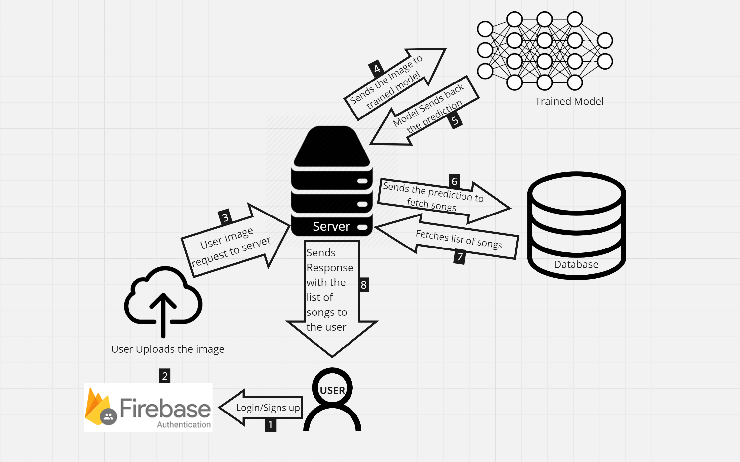
MVP DIAGRAM
MoodSphere

Slide 19
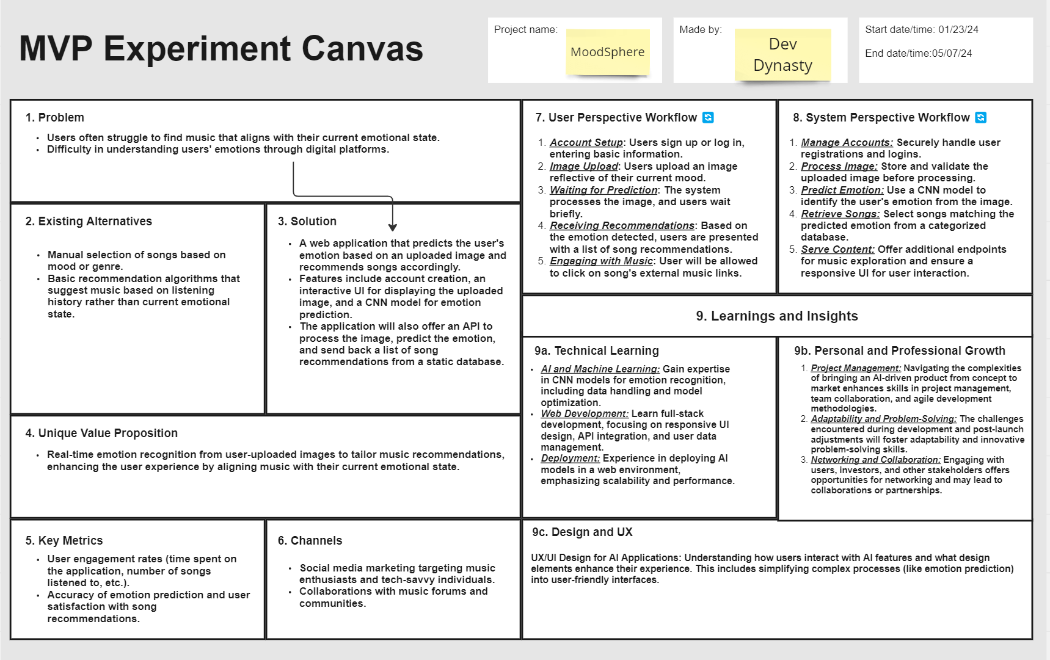

Slide 20
TECHNOLOGIES

Slide 21








Technologies
TensorFlow
React
Firebase
Python
HTML5
CSS3
Flask
Jira

Slide 22
Technologies description
TensorFlow will be the foundation for building the emotion detection engine of our music recommender.
Main applications of using TensorFlow will be Model Development and Real-Time Inference
React serves as the cornerstone for constructing the user interface (UI) of your music recommender app. Main applications of using React will be UI Design and Data Visualization
It is a suite of cloud-based services from Google that simplifies building mobile and web applications by providing features like: Authentication, Database Cloud Functions Hosting Analytics
Python supports OOP principles, allowing you to structure your code using classes and objects. This promotes code reusability, modularity, and maintainability, especially when dealing with complex data structures like user profiles and music recommendations.
MoodSphere

Slide 23
TECHNOLOGIES DESCRIPTION
HTML5 Defines the structure and content of web pages. Creates the basic building blocks of web pages using elements like headings, paragraphs, lists, images, and forms.
CSS3 controls the presentation of web pages, applying visual styles like fonts, colors, layout, and animations.
It defines styles that are applied to HTML elements, controlling their appearance.
High-level web framework built in Python, simplifying the development process for building web applications.
Can be employed to create the backend of your application, handling data processing, routing, and interacting with Jira
Project management software specifically designed for agile teams, facilitating task tracking, issue reporting, and collaboration.
MoodSphere

Slide 24
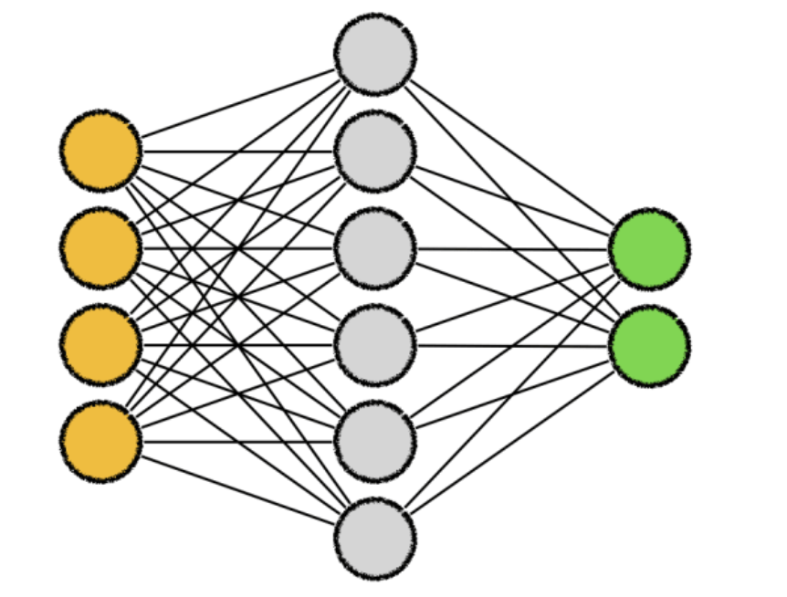


Algorithms AND EXPLANATION
Convolutional neural networks (CNNs) are a form of deep neural network that are frequently used in computer vision tasks like object detection, picture segmentation, and image recognition. When the term "CNN algorithm" is used, it usually refers to CNNs.
ResNet-50 is a deep convolutional neural network with 50 layers, renowned for its use of residual connections that aid in training very deep networks. Because of its outstanding performance in tasks like object identification, picture segmentation, and image classification, it has been frequently used in computer vision applications.
Keras is a popular Python framework that makes neural network construction and training (simple and straightforward). It provides an elevated interface to deep learning frameworks like as TensorFlow and Theano, facilitating swift model deployment and development.​
MoodSphere

Slide 25
Diagrams

Slide 26


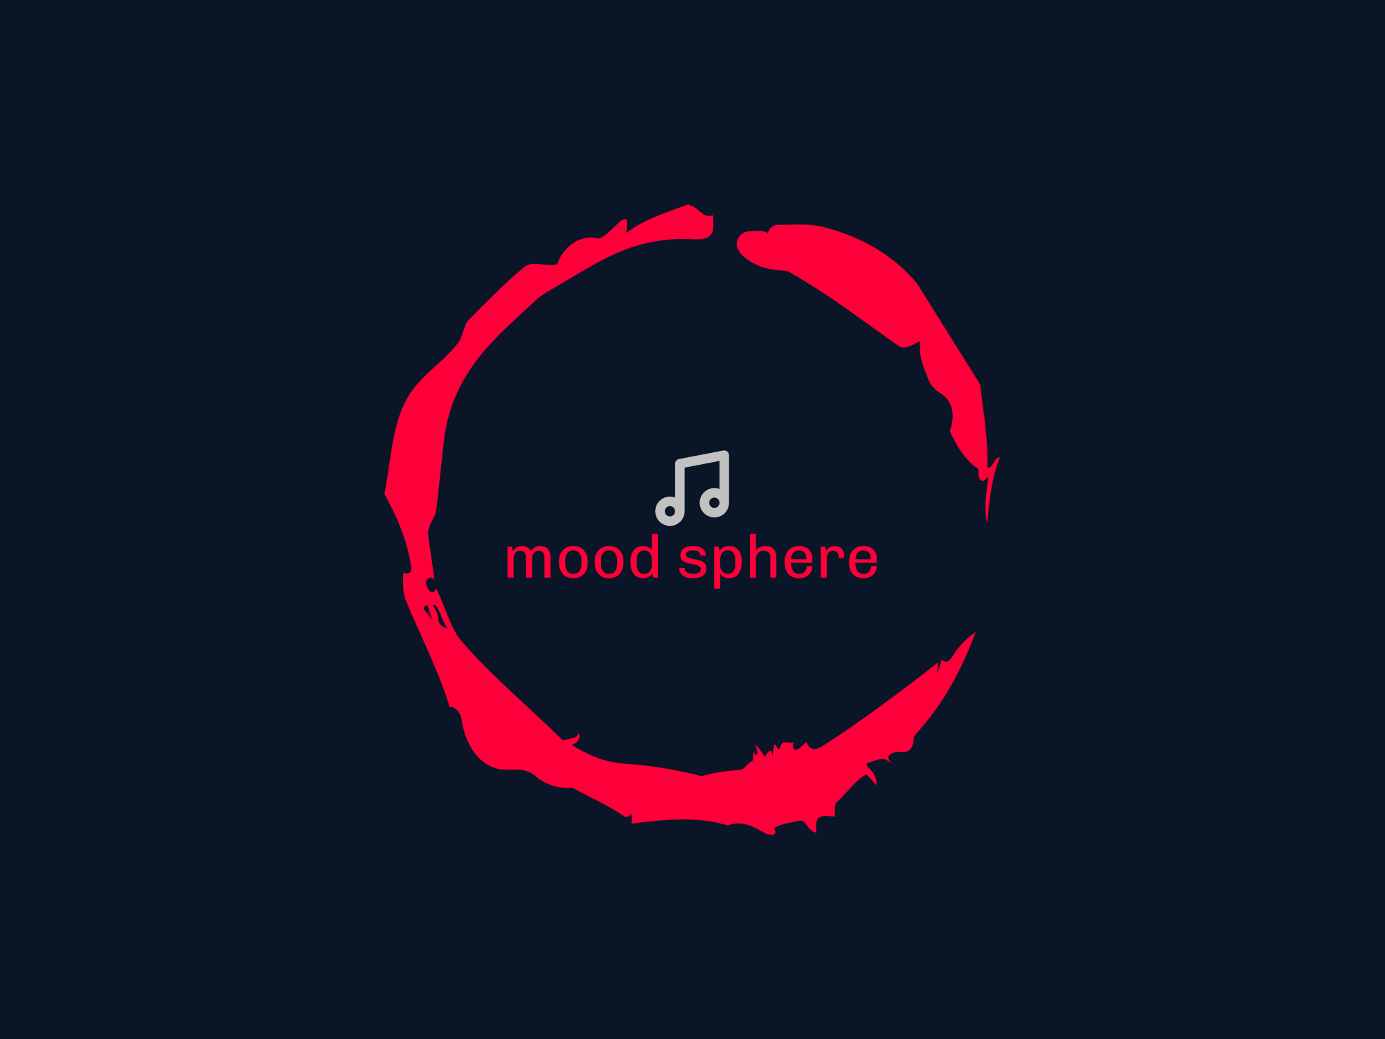


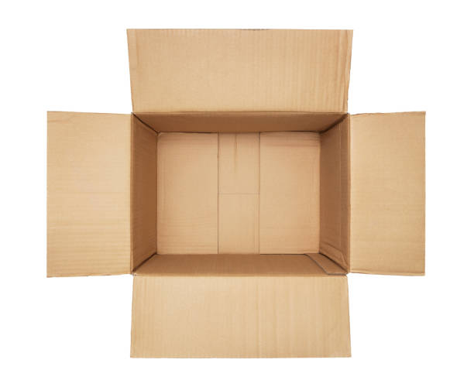
Architecture Diagram
user
Firebase database
MoodSphere
Input
API

Slide 27
Context Diagram
Upload Image
Mood
Sphere
API Out
Upload Image
API Call
Receive Mood
API In

Slide 28
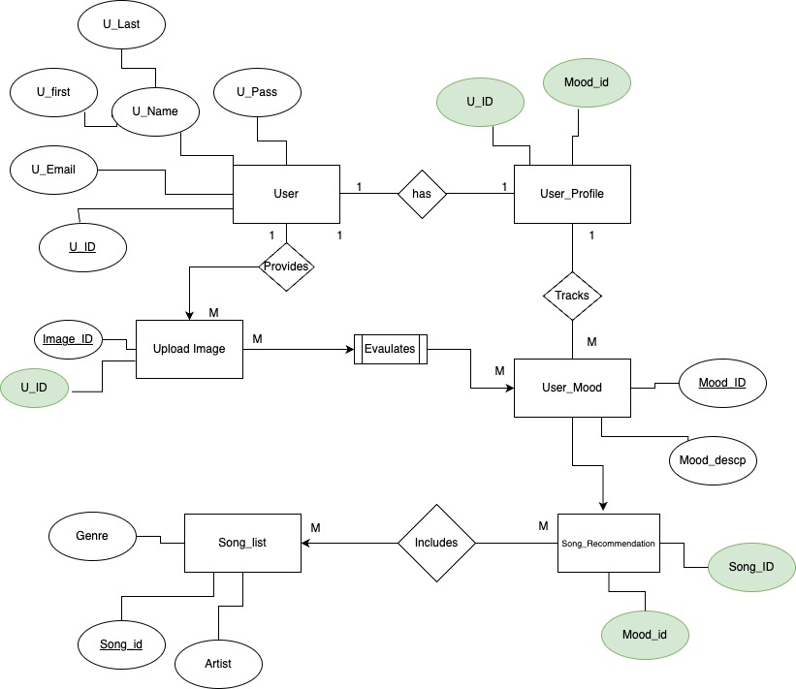
Entity relationship diagram

Slide 29
Sequence Diagram
Moodsphere
ML Model
Database
Upload Image
Analyze image
Predict Mood
API call requested for service
Sends the data to MoodSphere
Display the recommended song

Slide 30
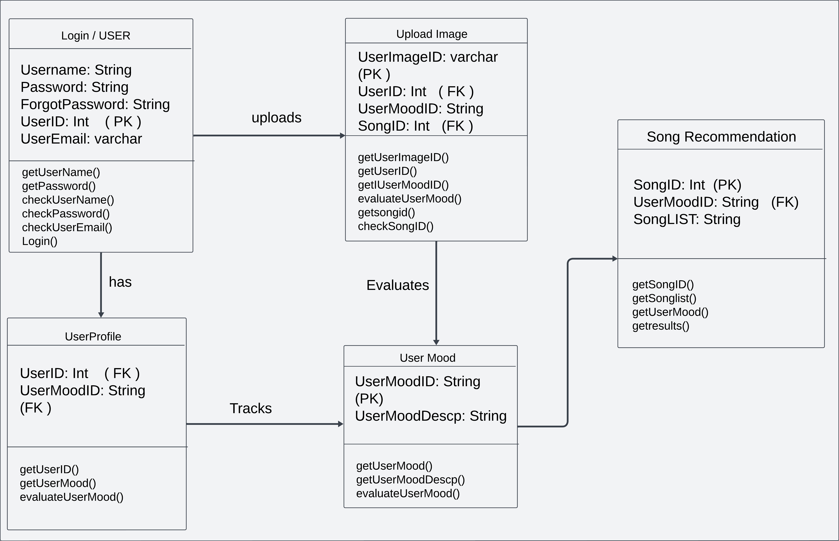
State diagram
MOODSPHERE 30

Slide 31
Class Diagram
User
User ID (int)
Email (String)
Password(String)
API call
URI (String)
Webapp
ML Algorithm
Mood Analyzer(String)
Database
Name (String)
Album (String)
Artist (String)
Id (int)
Mood(Sting)

Slide 32

SPRINT 3 RECAP

Slide 33
SPRINT 3 rECAP
Task ID | Story Points | User Story | Status | Sprint
MS_1 | 3 | As a Music Enthusiast, I want to be able to upload a picture representing my current mood From the Already Saved Images in the gallery | In Progress | Sprint - 3
 |  | Criteria, The user can upload an image file.Supported image formats include JPG, PNG, and GIF.
MS_2 | 5 | As a Music Enthusiast, I want the system to analyze the uploaded picture to determine my current mood More Precisely. | Done | Sprint - 3
 |  | Criteria, The system should use a CNN model to extract features from the image.The model should classify the mood into predefined categories (e.g., happy, sad, angry) More Precisely
MS_3 | 2 | As a Music Enthusiast, I want to see the predicted mood based on the uploaded picture. | Done | Sprint - 3
 |  | Criteria, The predicted mood should be displayed to the user.The mood prediction should be visually represented (e.g., emoticons).
MS_6 | 3 | As a Tech savvy, I want to be able to navigate the application easily and intuitively. | Done | Sprint - 3
 |  | Criteria, The application should have clear navigation menus and buttons.Users should be able to easily switch between different sections of the application.
 | MS_22 | 3 | As a Music Enthusiast, I want the application to display the mood category along with each recommended song. | Done | Sprint - 3
 |  |  | Criteria, Each recommended song entry should include the corresponding mood category.Mood categories should be clearly labeled and easy to distinguish.
MS_23 | 5 | As a song explorer, I want the application to provide recommendations based on my current mood, even if I'm not logged in or don't have an account. | In Progress | Sprint - 3
 |  | Criteria, Users should be able to access mood-based recommendations without requiring authentication or account creation.

Slide 34
SPRINT 3 recap
Task ID | Story Points | User Story | Status | Sprint
MS_7 | 5 | As a tech savvy, I want the application to be responsive and work well on different devices, including desktops, tablets, and smartphones. | Done | Sprint - 3
 |  | Criteria, The application should adapt to different screen sizes and resolutions.All features should be accessible and functional on various devices.
MS_8 | 5 | As a song explorer, I want to be able to search for specific songs or artists. | In Progress | Sprint - 3
 |  | Criteria, Users can search for songs or artists using a search bar.Search results should be relevant and displayed in a clear manner.
MS_12 | 5 | As a tech savvy, I want the application to provide an option to sort recommended songs based on popularity or other criteria. | Done | Sprint - 3
 |  | As a user, I want the application to provide an option to sort recommended songs based on popularity or other criteria.
MS_16 | 3 | As a song explorer, I want to be able to access external links associated with each recommended song. | Done | Sprint - 3
 |  | Criteria, The list of songs should include external links in one column, allowing users to access additional information or listen to the song.

Slide 35
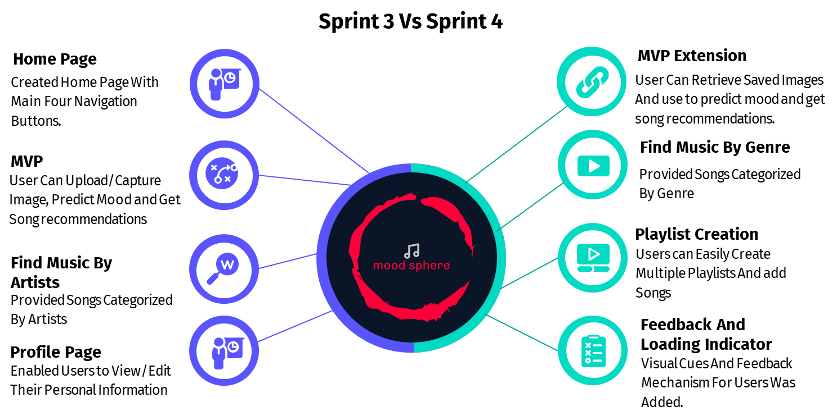
SPRINT 3 RECAP

Slide 36
product Backlog

Slide 37
PRODUCT BACKLOG
Story ID | Story Points | User Story | Assignee | Sprint
MS_4 | 3 | As a Music Enthusiast, I want to receive personalized music recommendations based on my current mood. | Mahesh | Sprint - 2
 |  | Criteria, The system should retrieve a list of songs associated with the predicted mood from a CSV file. Songs should be relevant and appropriate for the predicted mood.
MS_9 | 5 | As a Music Enthusiast, I want to be able to explore different moods and receive recommendations tailored to each mood. | Dhyey | Sprint - 2
 |  | Criteria, Users should have the option to select different moods and receive corresponding song recommendations.Each mood selection should provide a unique set of recommended songs.
MS_13 | 5 | As a Music Enthusiast, I want to be able to view and edit my profile information. | Urmil | Sprint - 2
 |  | Criteria, Users can view and update their profile information (e.g., name, email, profile picture).Profile editing should be straightforward and secure.
MS_14 | 5 | As a Traveller, I want to be able to sign up for an account to access personalized features and settings. | Dhyey | Sprint - 2
 |  | Criteria, Users can create a new account by providing necessary information (e.g., email, password).Account creation should include email verification for security purposes.
MS_18 | 5 | As a Music Enthusiast, I want the application to provide a diverse range of song recommendations for each mood, including different genres and styles based on the popularity of the song. | Mahesh | Sprint - 2
 |  | Criteria, Recommended songs should cover a variety of genres and musical preferences. Users should have options to explore different music styles within each mood category with the recommendation based on popularity.

Slide 38
PRODUCT BACKLOG​
Story ID | Story Points | User Story | Assignee | Sprint
MS_19 | 5 | As a Wellness Seeker, I want the application to be secure and protect my privacy when uploading pictures or interacting with the site. | Urmil | Sprint - 2
 |  | Criteria, The application should use HTTPS to encrypt data transmission. User data should be stored securely and not shared with third parties without consent.
MS_26 | 3 | As a Wellness Seeker, I want to view my current mood status without any song recommendations. | Krushil | Sprint - 2
 |  | Criteria, Users can navigate to a separate page or section to view their current mood status. The mood status should be displayed visually (e.g., emoticons) along with a text description
MS_1 | 3 | As a music Enthusiast, I want to be able to upload a picture representing my current mood From the Already Saved Images in the gallery | Shane | Sprint - 3
 |  | Criteria, The user can upload an image file. Supported image formats include JPG, PNG, and GIF.
MS_2 | 5 | As a Music enthusiast, I want the system to analyze the uploaded picture to determine my current mood More Precisely. | Mahesh | Sprint - 3
 |  | Criteria, The system should use a CNN model to extract features from the image. The model should classify the mood into predefined categories (e.g., happy, sad, angry) More Precisely
MS_3 | 2 | As a Music enthusiast, I want to see the predicted mood based on the uploaded picture. | Urmil | Sprint - 3
 |  | Criteria, The predicted mood should be displayed to the user. The mood prediction should be visually represented (e.g., emoticons).

Slide 39
PRODUCT BACKLOG​
Story ID | Story Points | User Story | Assignee | Sprint
MS_6 | 3 | As a tech savvy, I want to be able to navigate the application easily and intuitively. | Vijay | Sprint - 3
 |  | Criteria, The application should have clear navigation menus and buttons. Users should be able to easily switch between different sections of the application.
MS_7 | 5 | As a tech savvy, I want the application to be responsive and work well on different devices, including desktops, tablets, and smartphones. | Bhavik | Sprint - 3
 |  | Criteria, The application should adapt to different screen sizes and resolutions. All features should be accessible and functional on various devices.
MS_8 | 5 | As a song explorer, I want to be able to search for specific songs or artists. | Dhyey | Sprint - 3
 |  | Criteria, Users can search for songs or artists using a search bar. Search results should be relevant and displayed in a clear manner.
MS_12 | 5 | As a tech savvy, I want the application to provide an option to sort recommended songs based on popularity or other criteria. | Mahesh | Sprint - 3
 |  | Criteria, users want the application to provide an option to sort recommended songs based on popularity or other criteria.
MS_16 | 3 | As a song explorer, I want to be able to access external links associated with each recommended song. | Nisarg | Sprint - 3
 |  | Criteria, The list of songs should include external links in one column, allowing users to access additional information or listen to the song.

Slide 40
PRODUCT BACKLOG​
Story ID | Story Points | User Story | Assignee | Sprint
MS_22 | 3 | As a Music Enthusiast, I want the application to display the mood category along with each recommended song. | Shane | Sprint - 3
 |  | Criteria, Each recommended song entry should include the corresponding mood category. Mood categories should be clearly labeled and easy to distinguish.
MS_23 | 5 | As a Song explorer, I want the application to provide recommendations based on my current mood, even if I'm not logged in or don't have an account. | Urmil | Sprint - 3
 |  | Criteria, Users should be able to access mood-based recommendations without requiring authentication or account creation.
MS_5 | 5 | As a Music Enthusiast, I want to be able to save songs I like to a playlist for future reference. | Dhyey | Sprint - 4
 |  | Criteria, Users should have the option to add songs to a personal playlist. The playlist should persist across sessions for registered users.
MS_10 | 3 | As a Music Enthusiast, I want to be able to create and customize multiple playlists for different moods or occasions. | Mahesh | Sprint - 4
 |  | Criteria, Users can create new playlists and give them custom names. Users can add or remove songs from playlists.
MS_11 | 5 | As a Song explorer, I want the application to provide additional information about recommended songs | Krushil | Sprint - 4
 |  | Criteria, Users can access additional information about recommended songs by clicking on them. Information should be presented in a clear and concise manner.

Slide 41
PRODUCT BACKLOG​
Story ID | Story Points | User Story | Assignee | Sprint
MS_15 | 5 | As a Tech savvy, I want to be able to provide feedback on recommended songs or report any issues encountered while using the application. | Vijay | Sprint - 4
 |  | Criteria, Users should have a feedback mechanism to submit comments or report problems orproblems.
MS_17 | 3 | As a Song Explorer, I want to be able to clear my mood selection and start over if I'm not satisfied with the recommended songs. | Dhyey | Sprint - 4
 |  | Criteria, Users should have the option to clear their mood selection and return to the initial state. Clearing the mood selection should reset the recommended songs.
MS_20 | 3 | As a tech savvy, I want the application to provide clear instructions and guidance on how to use its features effectively. | Nisarg | Sprint - 4
 |  | Criteria, The application should include help documentation or tooltips to explain its functionality.
MS_21 | 3 | As a tech savvy, I want the application to display loading indicators or progress bars to indicate when mood analysis and song retrieval are in progress. | Shane | Sprint - 4
 |  | Criteria, Users should see visual cues indicating that the application is processing their request.Loading indicators should be displayed prominently and disappear once processing is complete.
MS_24 | 3 | As a song Explorer, I want the application to store uploaded pictures for future reference. | Mahesh | Sprint - 4
 |  | Criteria, Uploaded pictures should be saved securely in the user's account.Users should be able to access their stored pictures from their profile or settings.

Slide 42
PRODUCT BACKLOG​
Story ID | Story Points | User Story | Assignee | Sprint
MS_25 | 3 | As a Song explorer, I want the ability to delete uploaded pictures if needed. | Dhyey | Sprint - 4
 |  | Criteria, Users can delete uploaded pictures from their account. Deletion should be confirmed with a confirmation prompt to prevent accidental deletion.

Slide 43
Sprint summary

Slide 44
sprint-2 User Stories & BURNDOWN CHART

Slide 45
SPRINT 2 USER stories
Story ID | Story Points | User Story | Status | Sprint
MS_4 | 3 | As a Music Enthusiast, I want to receive personalized music recommendations based on my current mood. | Done | Sprint - 2
 |  | Criteria, The system should retrieve a list of songs associated with the predicted mood from a CSV file. Songs should be relevant and appropriate for the predicted mood.
MS_9 | 5 | As a Music Enthusiast, I want to be able to explore different moods and receive recommendations tailored to each mood. | Done | Sprint - 2
 |  | Criteria, Users should have the option to select different moods and receive corresponding song recommendations. Each mood selection should provide a unique set of recommended songs.
MS_13 | 5 | As a Music Enthusiast, I want to be able to view and edit my profile information. | Done | Sprint - 2
 |  | Criteria, Users can view and update their profile information (e.g., name, email, profile picture).Profile editing should be straightforward and secure.
MS_14 | 5 | As a Traveller, I want to be able to sign up for an account to access personalized features and settings. | Done | Sprint - 2
 |  | Criteria, Users can create a new account by providing necessary information (e.g., email, password). Account creation should include email verification for security purposes.
MS_18 | 5 | As a Music Enthusiast, I want the application to provide a diverse range of song recommendations for each mood, including different genres and styles based on the popularity of the song. | Done | Sprint - 2
 |  | Criteria, Recommended songs should cover a variety of genres and musical preferences.Users should have options to explore different music styles within each mood category with the recommendation based on popularity.

Slide 46
SPRINT 2 USER STORIES​
Story ID | Story Points | User Story | Status | Sprint
MS_19 | 5 | As a wellness seeker, I want the application to be secure and protect my privacy when uploading pictures or interacting with the site. | Done | Sprint - 2
 |  | Criteria, The application should use HTTPS to encrypt data transmission. User data should be stored securely and not shared with third parties without consent.
MS_26 | 3 | As a user, I want to view my current mood status without any song recommendations. | In Progress | Sprint - 2
 |  | Criteria, Users can navigate to a separate page or section to view their current mood status.The mood status should be displayed visually (e.g., emoticons) along with a text description

Slide 47
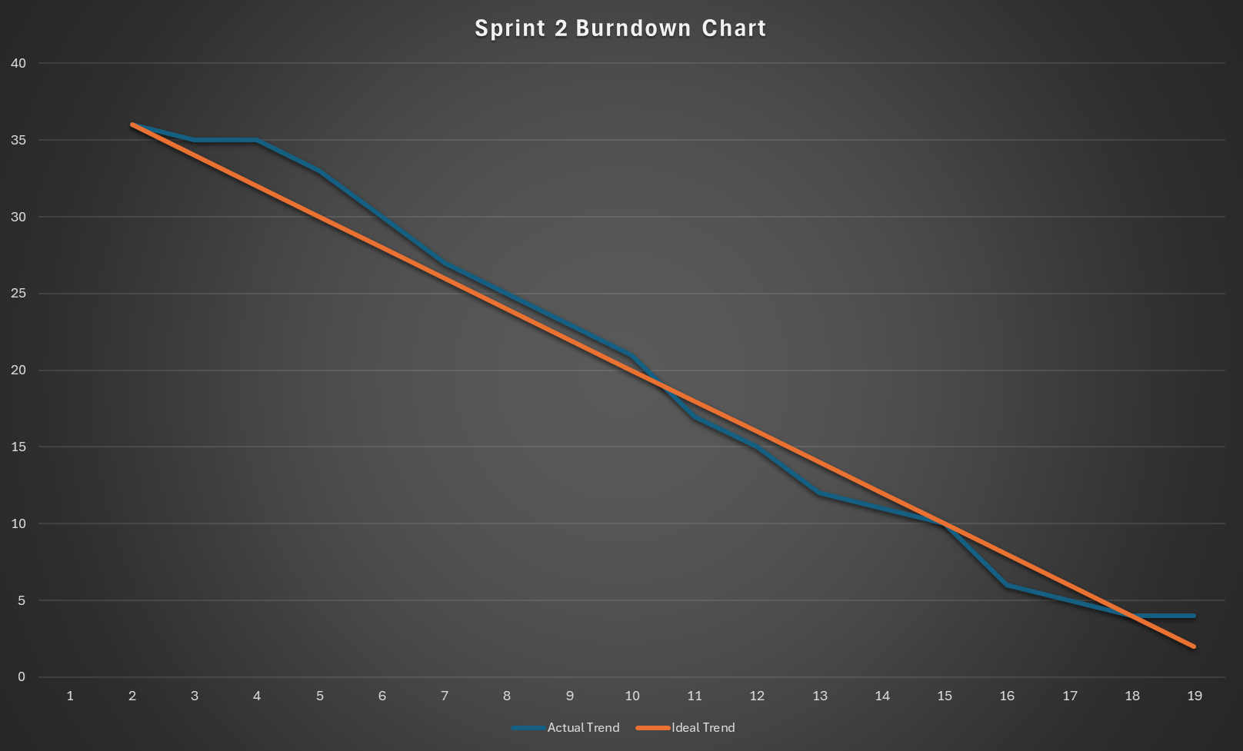
Sprint 2 Burndown Chart

Slide 48
sprint-3 user Stories & BURNDOWN CHART

Slide 49
SPRINT 3 USER STORIES​
Story ID | Story Points | User Story | Status | Sprint
MS_1 | 3 | As a Music Enthusiast, I want to be able to upload a picture representing my current mood From the Already Saved Images in the gallery | In Progress | Sprint - 3
 |  | Criteria, The user can upload an image file. Supported image formats include JPG, PNG, and GIF.
MS_2 | 5 | As a Music Enthusiast, I want the system to analyze the uploaded picture to determine my current mood More Precisely. | Done | Sprint - 3
 |  | Criteria, The system should use a CNN model to extract features from the image. The model should classify the mood into predefined categories (e.g., happy, sad, angry) More Precisely
MS_3 | 2 | As a Music Enthusiast, I want to see the predicted mood based on the uploaded picture. | Done | Sprint - 3
 |  | Criteria, The predicted mood should be displayed to the user.The mood prediction should be visually represented (e.g., emoticons).
MS_6 | 3 | As a tech savvy, I want to be able to navigate the application easily and intuitively. | Done | Sprint - 3
 |  | Criteria, The application should have clear navigation menus and buttons.Users should be able to easily switch between different sections of the application.
MS_22 | 3 | As a Music Enthusiast, I want the application to display the mood category along with each recommended song. | Done | Sprint - 3
 |  | Criteria, Each recommended song entry should include the corresponding mood category.Mood categories should be clearly labeled and easy to distinguish.

Slide 50
SPRINT 3 USER STORIES​
Story ID | Story Points | User Story | Status | Sprint
MS_23 | 5 | As a Song Explorer, I want the application to provide recommendations based on my current mood, even if I'm not logged in or don't have an account. | In Progress | Sprint - 3
 |  | Criteria, Users should be able to access mood-based recommendations without requiring authentication or account creation.
MS_7 | 5 | As a tech savvy, I want the application to be responsive and work well on different devices, including desktops, tablets, and smartphones. | Done | Sprint - 3
 |  | Criteria, The application should adapt to different screen sizes and resolutions.All features should be accessible and functional on various devices.
MS_8 | 5 | As a song explorer, I want to be able to search for specific songs or artists. | In Progress | Sprint - 3
 |  | Criteria, Users can search for songs or artists using a search bar.Search results should be relevant and displayed in a clear manner.
MS_12 | 5 | As a tech savvy, I want the application to provide an option to sort recommended songs based on popularity or other criteria. | Done | Sprint - 3
 |  | As a user, I want the application to provide an option to sort recommended songs based on popularity or other criteria.
MS_16 | 3 | As a song explorer, I want to be able to access external links associated with each recommended song. | Done | Sprint - 3
 |  | Criteria, The list of songs should include external links in one column, allowing users to access additional information or listen to the song.

Slide 51
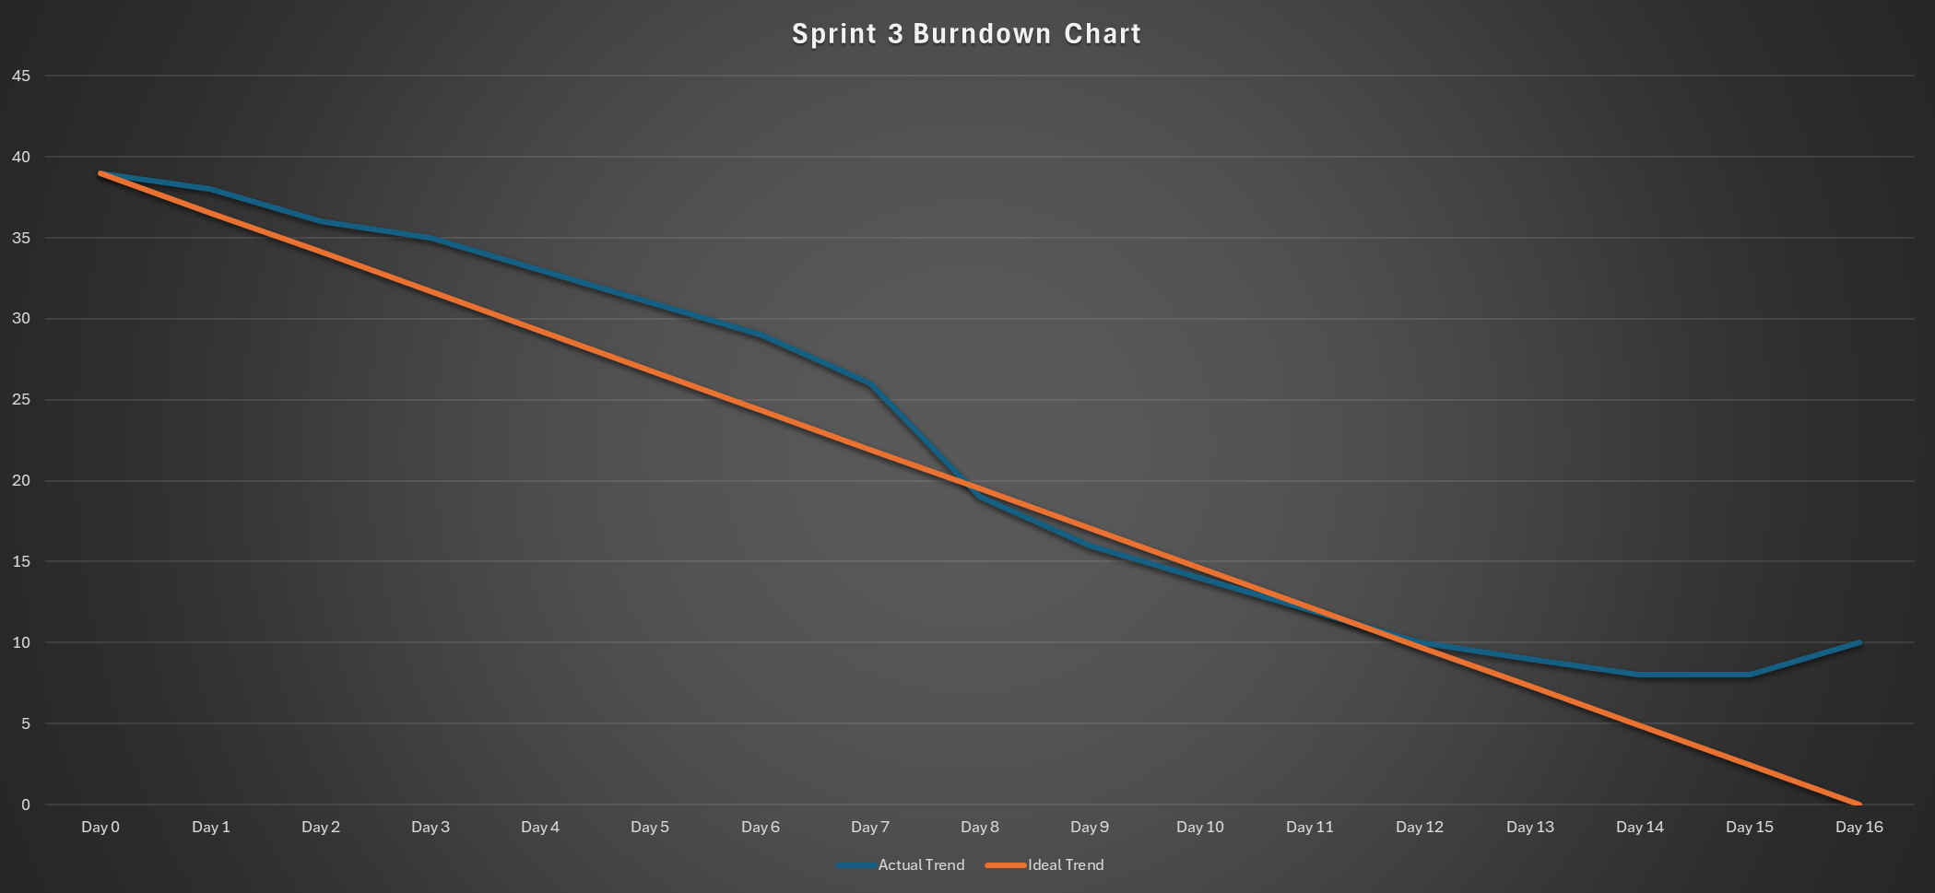
Sprint 3 Burndown Chart

Slide 52
sprint-4 Backlog

Slide 53
SPRINT 4 BACKLOG
Story ID | Story Points | User Story | Status | Sprint
MS_5 | 5 | As a Music Enthusiast, I should have an option to add songs to a personal playlist | Done | Sprint - 4
 |  | Criteria, Users should have the option to add songs to a personal playlist. The playlist should persist across sessions for registered users.
MS_10 | 3 | As a Music Enthusiast, I want to be able to create and customize multiple playlists for different moods or occasions. | Done | Sprint - 4
 |  | Criteria, Users can create new playlists and give them custom names. Users can add or remove songs from playlists.
MS_11 | 5 | As a Song explorer, I want the application to provide additional information about recommended songs | Done | Sprint - 4
 |  | Criteria, Users can access additional information about recommended songs by clicking on them. Information should be presented in a clear and concise manner.
MS_21 | 3 | As a Tech savvy, I want the application to display loading indicators or progress bars to indicate when mood analysis and song retrieval are in progress. | Done | Sprint - 4
 |  | Criteria, Users should see visual cues indicating that the application is processing their request. Loading indicators should be displayed prominently and disappear once processing is complete.
MS_24 | 3 | As a Tech savvy, I want the application to store uploaded pictures for future reference. | Done | Sprint - 4
 |  | Criteria, Uploaded pictures should be saved securely in the user's account. Users should be able to access their stored pictures from their profile or settings.

Slide 54
SPRINT 4 BACKLOG​
Story ID | Story Points | User Story | Status | Sprint
MS_15 | 5 | As a tech savvy, I want to be able to provide feedback on recommended songs or report any issues encountered while using the application. | Done | Sprint - 4
 |  | Criteria, Users should have a feedback mechanism to submit comments or report problems or problems.
MS_17 | 3 | As a song explorer, I want to be able to clear my mood selection and start over if I'm not satisfied with the recommended songs. | Done | Sprint - 4
 |  | Criteria, Users should have the option to clear their mood selection and return to the initial state. Clearing the mood selection should reset the recommended songs.
MS_20 | 3 | As a tech savvy, I want the application to provide clear instructions and guidance on how to use its features effectively. | Done | Sprint - 4
 |  | Criteria, The application should include help documentation or tooltips to explain its functionality.
MS_25 | 3 | As a song explorer, I want the ability to delete uploaded pictures if needed. | In Progress | Sprint - 4
 |  | Criteria, Users can delete uploaded pictures from their account. Deletion should be confirmed with a confirmation prompt to prevent accidental deletion.
Total Story Points: 33

Slide 55
Testcases For sprint-4 Backlog

Slide 56
SPRINT 4 Test Cases
Test ID | Story ID | Test Scenario | Test Case | Test Steps | Test Data | Expected Result | Actual Result | Pass/Fail
TC_MS21_01 | MS_21 | Verify display of loading indicators during mood analysis and song retrieval. | Displaying Loading Indicators | 1.Trigger the mood analysis or song retrieval process by uploading an image. | JPG/PNG File | The application should visually indicate progress with loading indicators during data processing. | Can see the Loading indicator until it fetches the songs. | pass
 |  |  |  | 2.Observe the application interface for loading indicators or progress bars.
 |  |  |  | 3.Monitor the progress until the analysis or retrieval is complete.
TC_MS8_01 | MS_8 | Verify the functionality to search for specific songs or artists. | Searching for Songs and Artists | 1.Access the search feature within the application. | Song titles, artist names. | The application should return accurate search results based on the entered query if it is in the Database. | Should show the respective songs based on the search and the existence of the data. | pass
 |  |  |  | 2. Enter a song title or artist name in the search bar, Submit the search query to check results
TC_MS5_01 | MS_5 | Verify the ability to save liked songs to a playlist. | Saving Liked Songs in the recommendation. | 1.Select a song from the recommended list. | Liked songs, playlist creation. | The selected song should be saved and accessible within the designated playlist. | Can see the Song in the respective playlist | pass
 |  |  |  | 2.Locate the option(+) to add the liked song to a playlist.
 |  |  |  | 3.Choose a playlist to add the song or create one and confirm that the song has been successfully saved to the playlist.
TC_MS10_01 | MS_10 | Verify the creation and customization of multiple playlists. | Creating Custom Playlists | 1.Navigate to the playlist section and Check for the delete option on the existing playlist. | Playlist names | The application should allow the user to create and delete multiple playlists based on different moods or occasions. | Can be able to delete and create multiple playlists. | pass
 |  |  |  | 2.Select a song from the recommended list and create multiple playlists.
TC_MS15_01 | MS_15 | Verify the ability to provide feedback or report issues on application | Providing Feedback or reporting an issue | 1.Locate the report option on the home page. | Song recommendation feedback, issue reporting. | The application should accept users input and send an email to the development mail address. | Take the submitted and send an email to the applications email ID. | pass
 |  |  |  | 2.Click on the Report and write your issue and click on the submit button.

Slide 57
SPRINT 4 TEST CASES​
Test ID | Story ID | Test Scenario | Test Case | Test Steps | Test Data | Expected Result | Actual Result | Pass/Fail
TC_MS23_01 | MS_23 | Verify recommendations based on user's current mood without logging in. | Recommendations for Anonymous Users | 1. Open the application without logging into any user account. | Navigating without entering logging information to upload the picture | The application should successfully recommend songs based on the selected mood, even for anonymous users. | Uploaded Image is successfully passed to the CNN model and getting the recommendation. | pass
 |  |  |  | 2. Locate the mood Status feature on the homepage.
 |  |  |  | 3. Click on the upload button to upload your image and check the recommendations
TC_MS17_01 | MS_17 | Verify the ability to clear mood selection(Remove Button) and start over. | Clearing Mood Selection | 1.Navigate to the mood Status feature within the application. | Navigate to the Mood Status Feature to find the Remove button | The selected mood should be cleared, allowing the user to choose a new mood for song recommendations. | Recommendations are successfully cleared. | pass
 |  |  |  | 2. Upload your image and get the recommendations.
 |  |  |  | 3. Click on the Remove button to clear the Recommendations to start over.
TC_MS24_01 | MS_24 | Verify uploaded pictures are stored for future reference. | Storing Uploaded Pictures | 1.Navigate to the mood Status feature within the application. | JPG/PNG File | The uploaded pictures should be Stored in DB and accessible after logging out and logging back into the application. | Can Access the image from DB | pass
 |  |  |  | 2. Upload your image and get the recommendations.
 |  |  |  | 3.Check for the pop-up Image uploaded to FireStore
TC_MS12_01 | MS_12 | Verify sorting of recommended songs based on popularity. | Sorted Recommended Songs | Check if the Recommended Songs are Displayed in Ascending order with our DataSet. | List of Recommended Songs | Songs being displayed in ascending order | Navigation buttons are working | pass
TC_MS11_01 | MS_11 | Verify access to additional information about recommended songs. | Accessing Song Information | 1.Choose a recommended song from the list. | Recommended songs. | The application should provide more information about the selected song upon clicking the option(i). | Can clearly be able to see addition information from initial results. | pass
 |  |  |  | 2.Look for option(i) to access additional information (e.g., artist details, album info).
TC_MS20_01 | MS_20 | Verify clarity of instructions and guidance within the application. | Checking Instructions | Navigate to home and click on the option User Guide. | User interaction with the application. | The application should offer User instructions and guide on using its features effectively. | Can clearly be able to navigate and see the results | pass

Slide 58
Completed stories in sprint-4
MOODSPHERE 58

Slide 59
Sprint 4 completed Stories
Story ID | Story Points | User Story | Status | Sprint
MS_1 | 3 | As a Music Enthusiast, I want to be able to upload a picture representing my current mood From the Already Saved Images in the gallery | Done | Sprint - 4
 |  | Criteria, The user can upload an image file. Supported image formats include JPG, PNG, and GIF.
MS_8 | 5 | As a Song Explorer, I want to be able to search for specific songs or artists. | Done | Sprint - 4
 |  | Criteria, Users can search for songs or artists using a search bar. Search results should be relevant and displayed in a clear manner.
MS_23 | 5 | As a Song Explorer, I want the application to provide recommendations based on my current mood, even if I'm not logged in or don't have an account. | Done | Sprint - 4
 |  | Criteria, Users should be able to access mood-based recommendations without requiring authentication or account creation.
MS_5 | 5 | As a Music Enthusiast, I want to be able to save songs I like to a playlist for future listening. | Done | Sprint - 4
 |  | Criteria, Users should have the option to add songs to a personal playlist. The playlist should persist across sessions for registered users.
MS_10 | 3 | As a Music Enthusiast, I want to be able to create and customize multiple playlists for different moods or occasions. | Done | Sprint - 4
 |  | Criteria, Users can create new playlists and give them custom names. Users can add or remove songs from playlists.
MS_11 | 5 | As a Song Explorer, I want the application to provide additional information about recommended songs | Done | Sprint - 4
 |  | Criteria, Users can access additional information about recommended songs by clicking on them. Information should be presented in a clear and concise manner.

Slide 60
Sprint 4 completed Stories​
Story ID | Story Points | User Story | Status | Sprint
MS_15 | 5 | As a Tech savvy, I want to be able to provide feedback on recommended songs or report any issues encountered while using the application. | Done | Sprint - 4
 |  | Criteria, Users should have a feedback mechanism to submit comments or report problems.
MS_17 | 3 | As a Song Explorer, I want to be able to clear my mood selection and start over if I'm not satisfied with the recommended songs. | Done | Sprint - 4
 |  | Criteria, Users should have the option to clear their mood selection and return to the initial state. Clearing the mood selection should reset the recommended songs.
MS_20 | 3 | As a Tech savvy, I want the application to provide clear instructions and guidance on how to use its features effectively. | Done | Sprint - 4
 |  | Criteria, The application should include help documentation or tooltips to explain its functionality.
MS_21 | 3 | As a Song Explorer, I want the application to display loading indicators or progress bars to indicate when mood analysis and song retrieval are in progress. | Done | Sprint - 4
 |  | Criteria, Users should see visual cues indicating that the application is processing their request. Loading indicators should be displayed prominently and disappear once processing is complete.
MS_24 | 3 | As a Song Explorer, I want the application to store uploaded pictures for future reference. | Done | Sprint - 4
 |  | Criteria, Uploaded pictures should be saved securely in the user's account. Users should be able to access their stored pictures from their profile or settings.

Slide 61
inCompleted stories in sprint-4
MOODSPHERE 61

Slide 62
SPRINT 4 INCOMPLETED STORIES
Story ID | Story Points | User Story | Status | Sprint
MS_25 | 3 | As a Song Explorer, I want the ability to delete uploaded pictures if needed. | In Progress | Sprint - 4
 |  | Criteria, Users can delete uploaded pictures from their account. Deletion should be confirmed with a confirmation prompt to prevent accidental deletion.

Slide 63
metrics

Slide 64
Sprint -4 Team Velocity

Slide 65
Team velocity for sprint- 4 is (Number of completed Story Points) = 43

Slide 66
Team’s Historical(AVG) Velocity

Slide 67
Average Velocity =
Sum of Velocities for Completed Sprints Number of completed sprints
Historical Velocity of Moodsphere is 34

Slide 68
Burndown charts

Slide 69
Sprint-4 Burndown chart

Slide 70
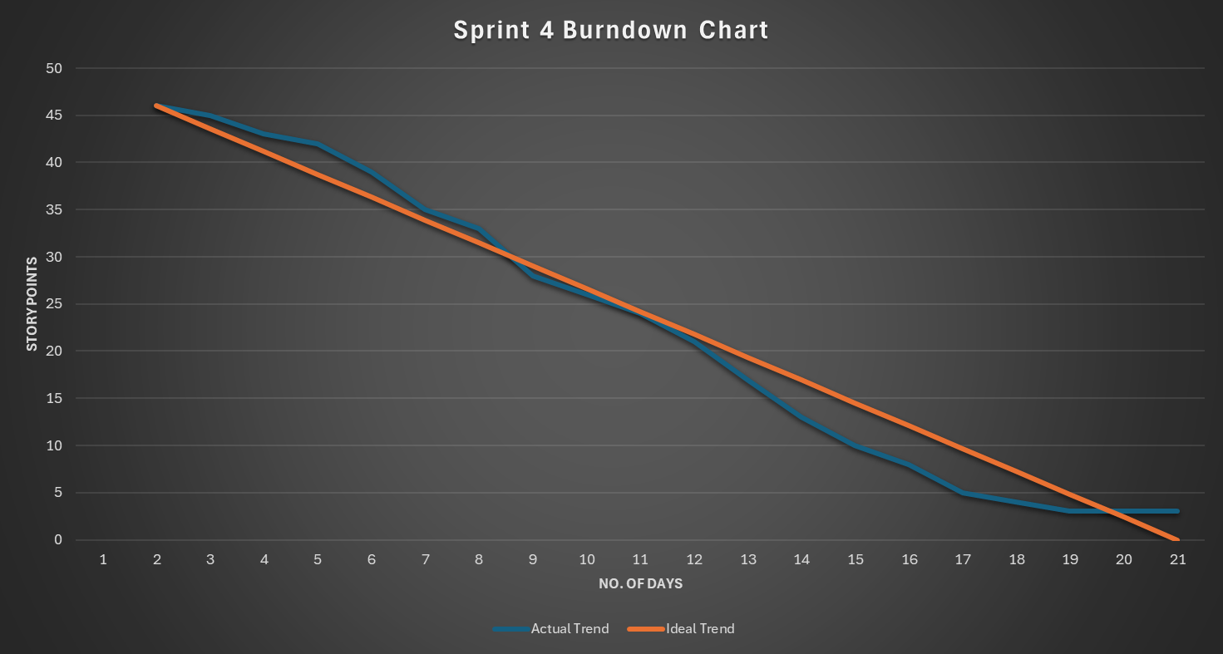
Sprint 4 Burndown Chart

Slide 71
Average Burndown chart
Average Burndown Rate = Total Variance/ Total Number of Intervals
Where:
Total Variance = Σ (Ideal Burndown - Actual Burndown) for all intervals
Total Number of Intervals = Number of intervals (e.g., days, weeks) during the project duration. In our Case it is 3days.

Slide 72
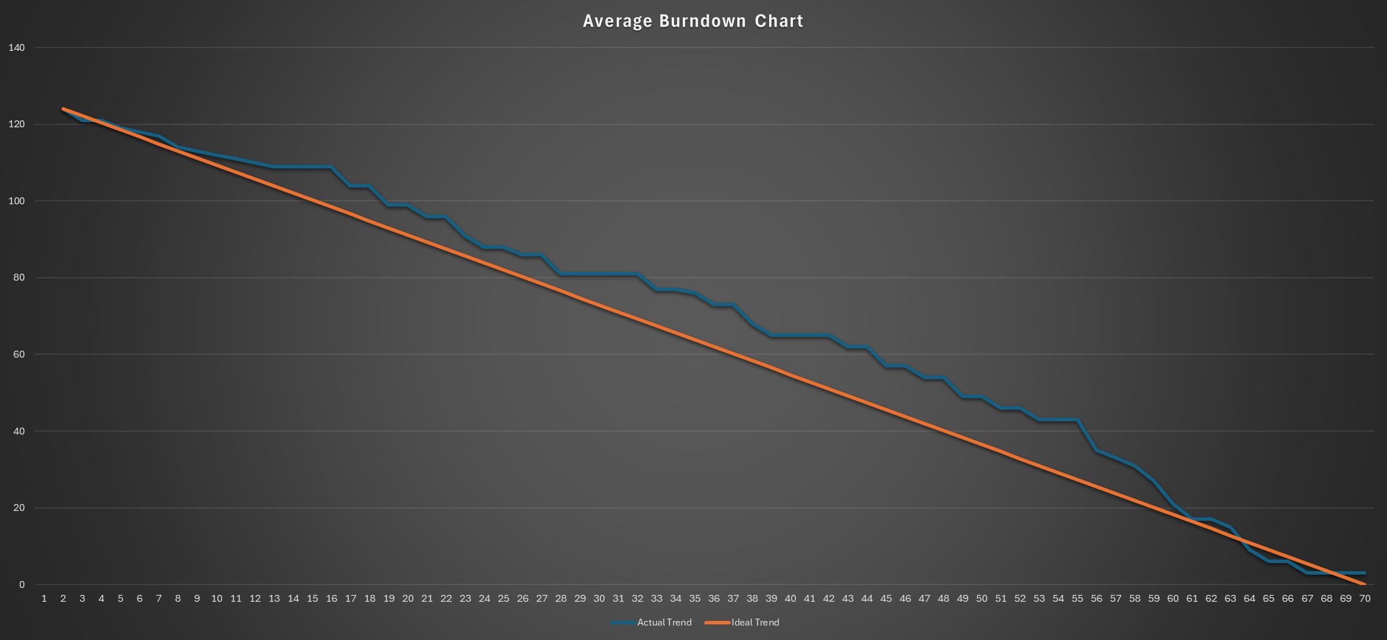
Average Burndown Chart

Slide 73
Historical Burndown chart
Historical burndown chart = Sum(Sprint 1 + Sprint 2 + Sprint 3 + Sprint 4)

Slide 74
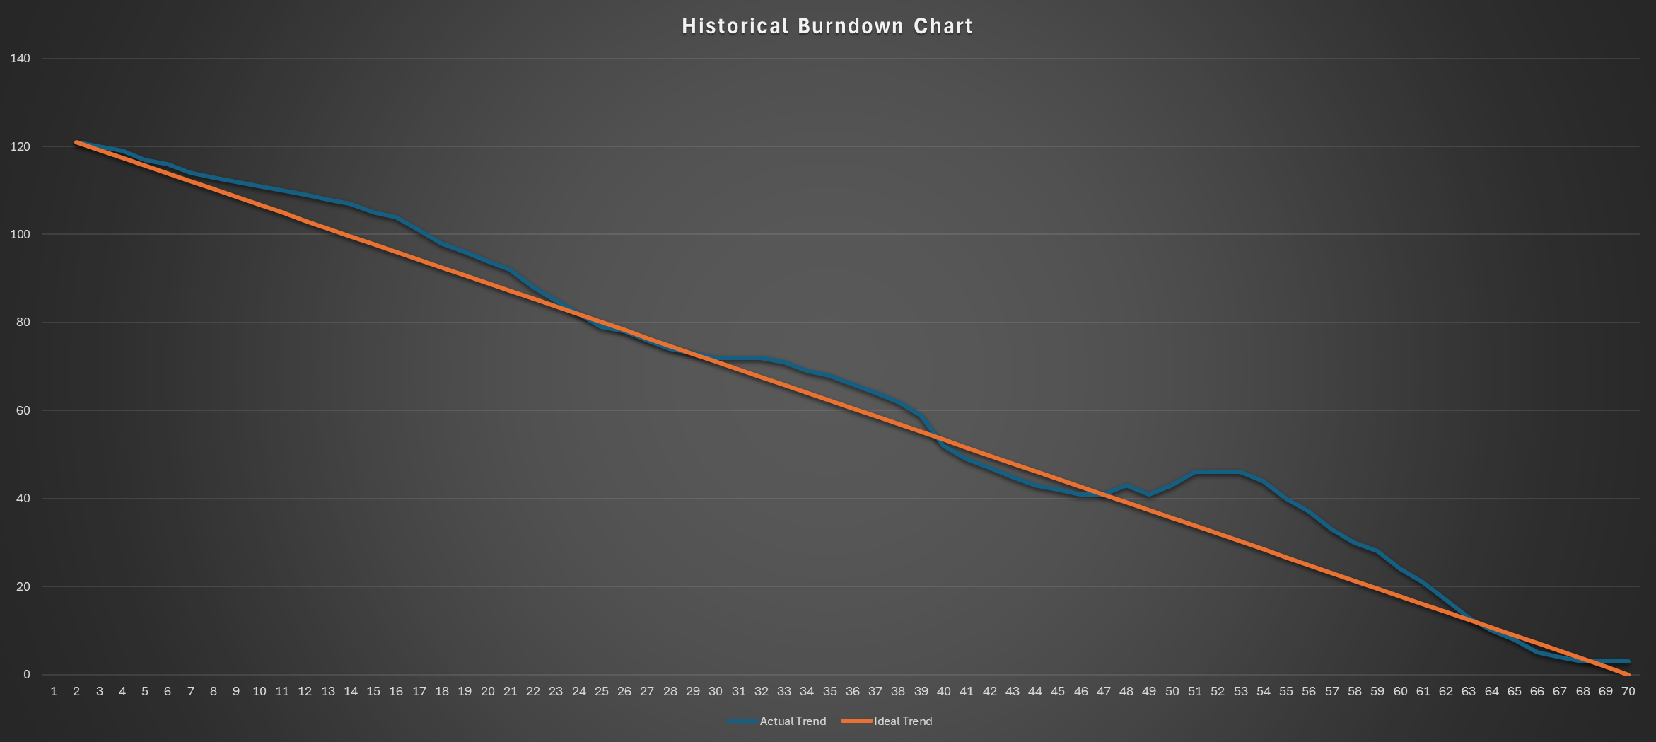
Historical Burndown Chart

Slide 75
Sprint- 4 Completed/committed Ratio

Slide 76
Completed/committed Ratio for Sprint – 4 is
43/46 = 93.47%

Slide 77
Average Completed/committed Ratio

Slide 78
Average Ratio =
AvG(Sprint-2 +sprint-3 + SPRINT 4 Ratio)
Average Ratio is - 83.93%

Slide 79
Historic Completed/committed Ratio

Slide 80
Historic Ratio =
Total completed work Total committed work
Historic Ratio is – 83.93%

Slide 81
RETROSPECTIVE
MoodSphere

Slide 82
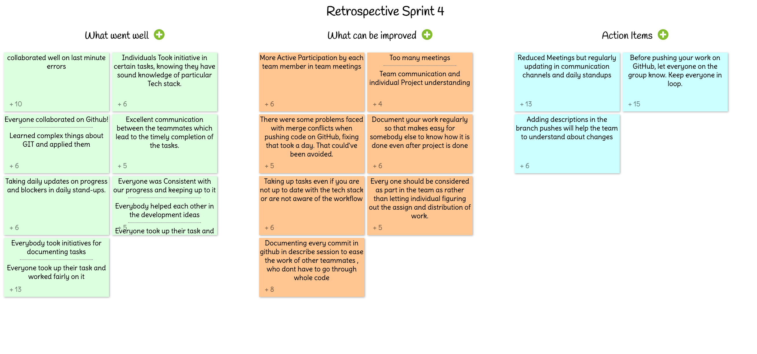

Slide 83
Retrospective Sprint-4
What went Well?
The team collaborated effectively, even when addressing last-minute errors. Certain individuals demonstrated initiative by taking charge of tasks they were knowledgeable about in specific tech stacks
Collaboration on GitHub was consistent across the board. Complex aspects of Git were learned and successfully applied.
Daily stand-ups were utilized to provide updates on progress and address any blockers. Consistency in progress was maintained by all team members.
Development ideas were collectively brainstormed, with everyone pitching in to help. Each team member took ownership of their tasks and worked diligently on them.
What can we do better
Active participation by each team member in team meetings is essential for effective collaboration. Improving team communication and ensuring everyone understands individual project requirements is crucial.
Taking on tasks, even if one isn't fully familiar with the tech stack or workflow, can be beneficial for learning and team flexibility.
Assigning and distributing work should involve everyone in the team, rather than leaving it to individuals.
Actions items
We will be regularly updating through communication channels and daily standups.
Before pushing your work on GitHub, make sure to let everyone in the group know. Keeping everyone in the loop is crucial. Additionally, adding descriptions in the branch pushes will help the team understand the changes being made.

Slide 84
PROJECT DEMO

Slide 85
App Screenshots

Slide 86
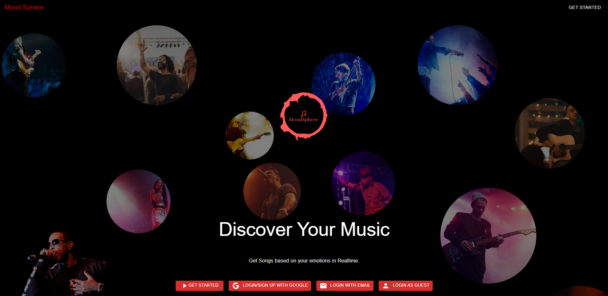
Landing Page

Slide 87
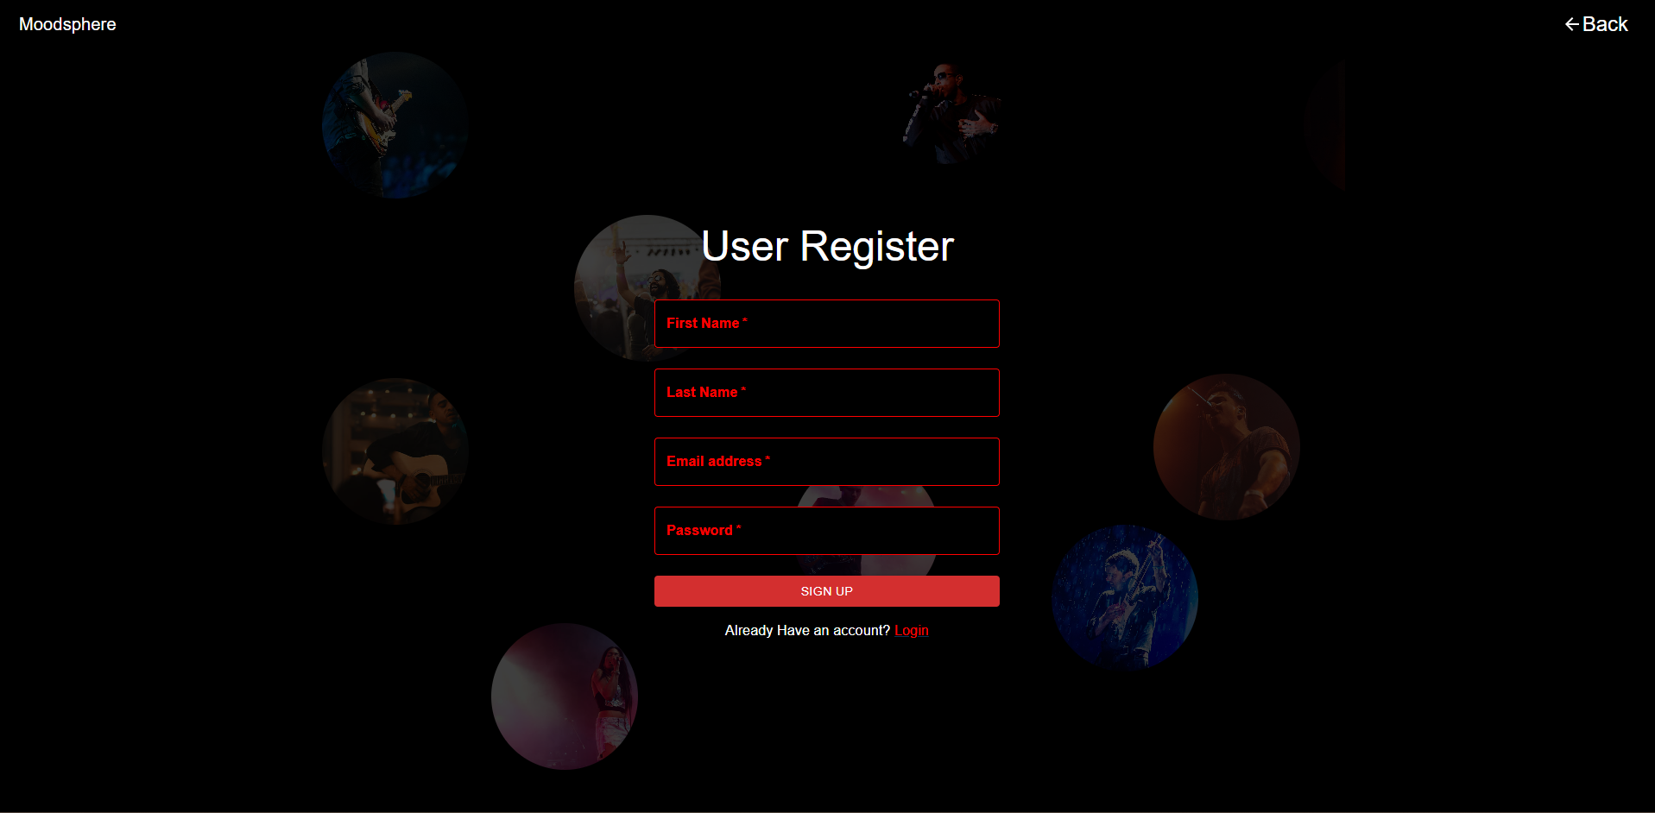
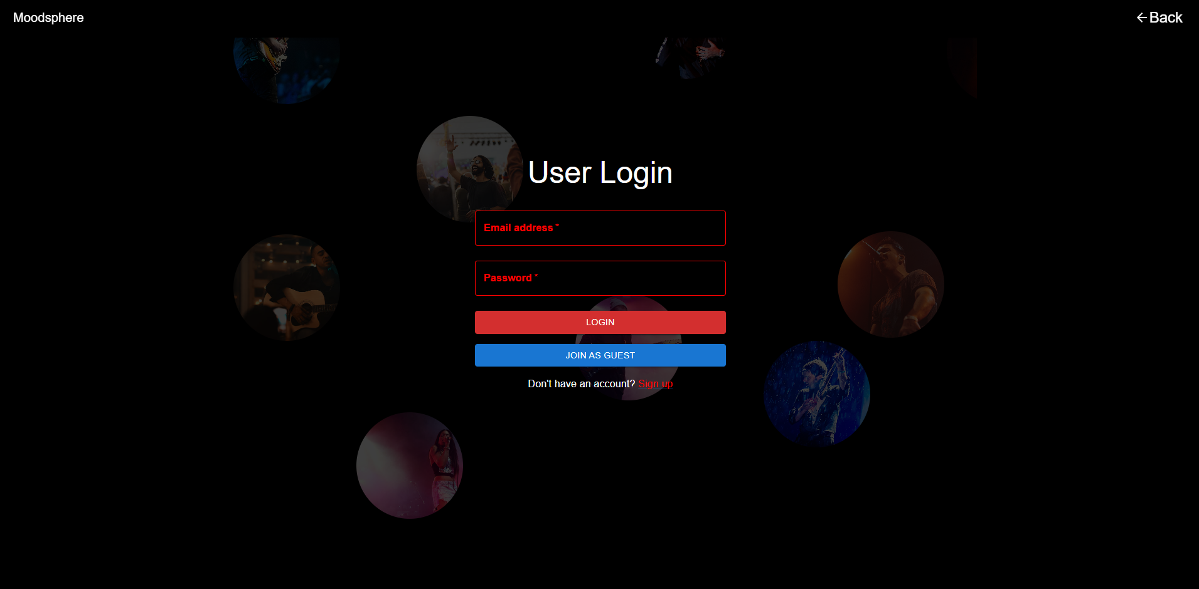
Signup
Login

Slide 88
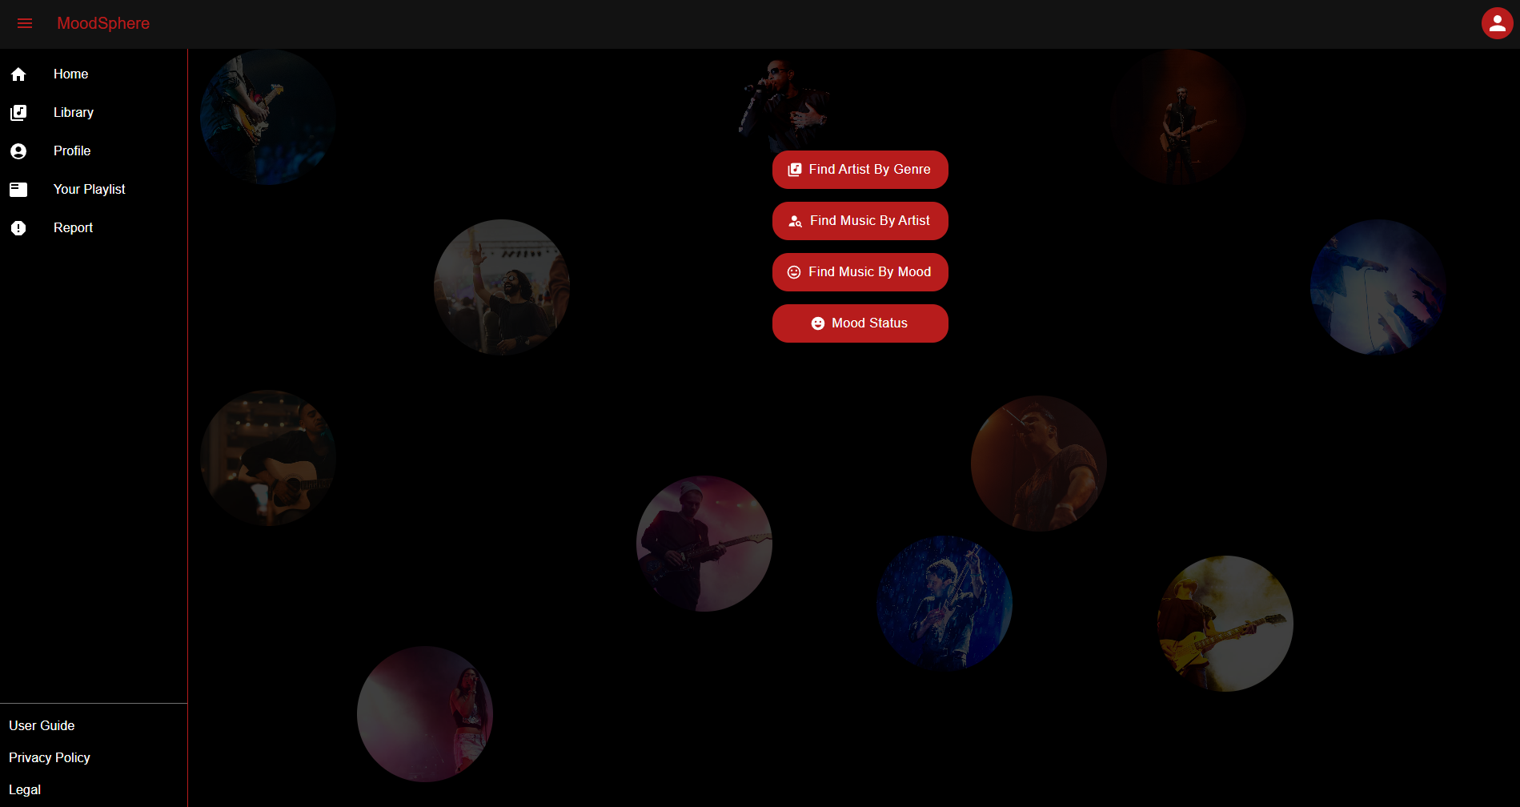
Home Page

Slide 89
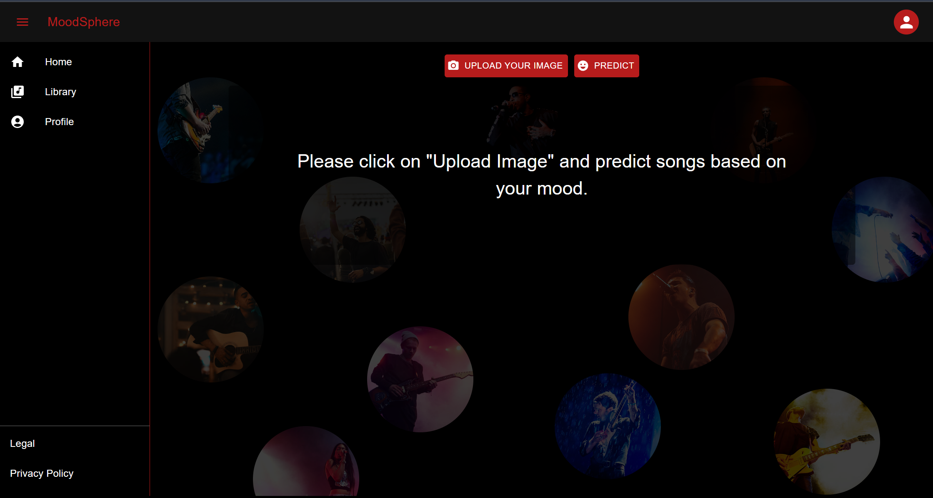
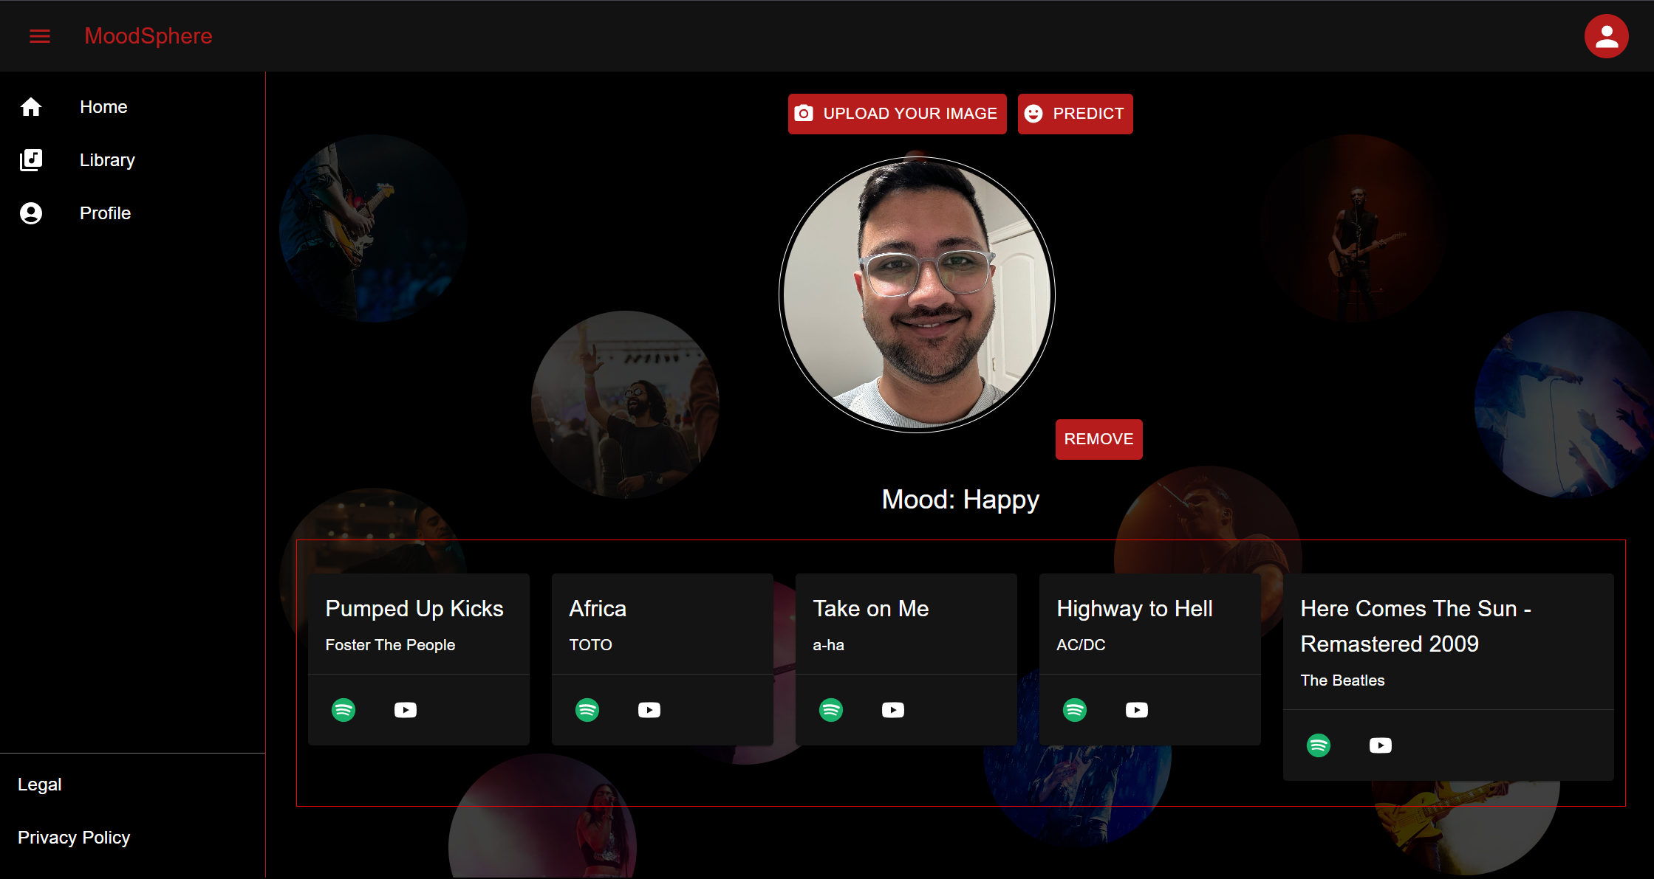
Mood Prediction and Song Recommendation

Slide 90
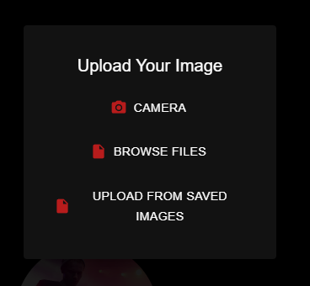
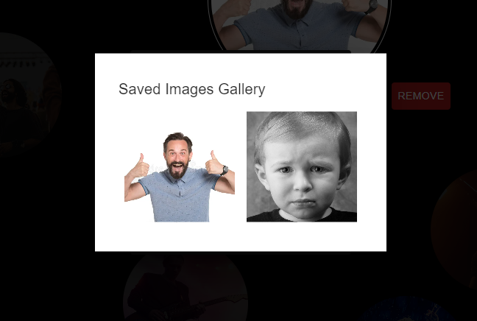
Saved Images Gallery

Slide 91
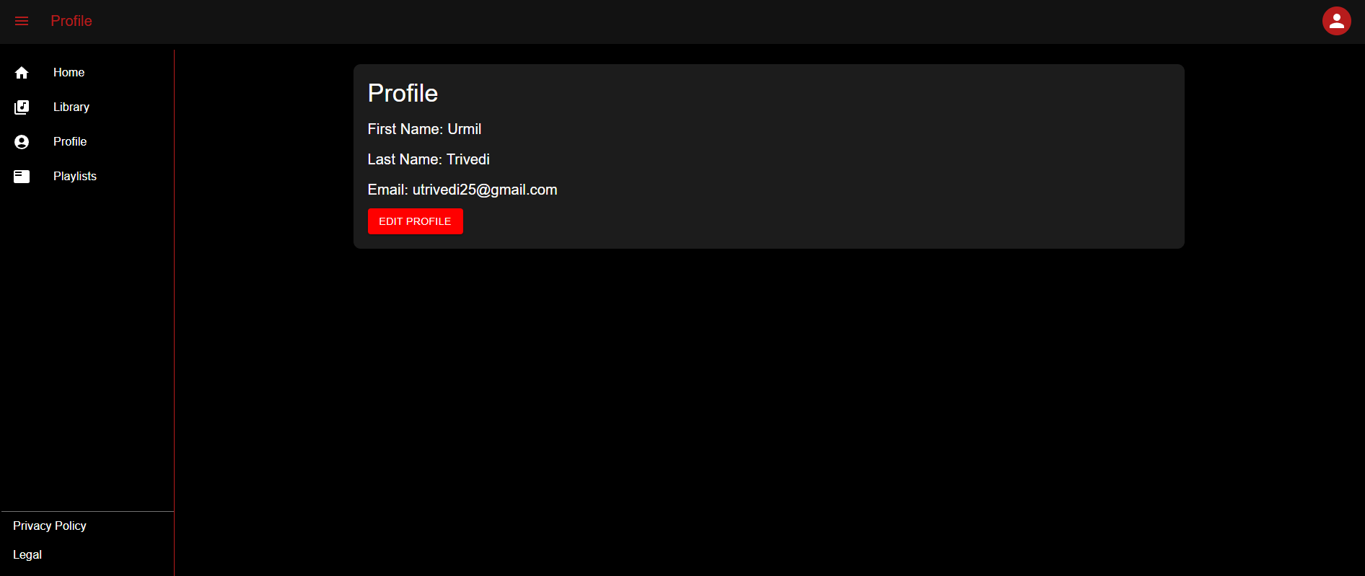
Profile Page

Slide 92
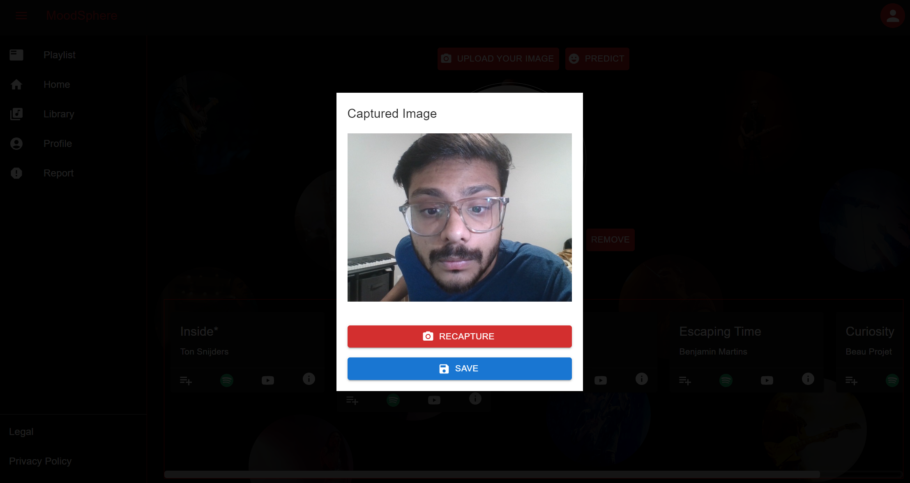
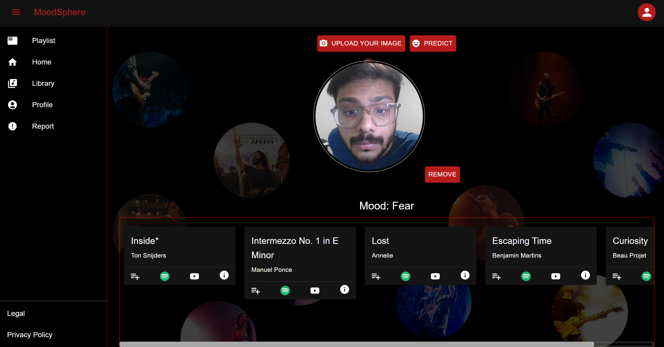
User Clicked picture and Recommendation

Slide 93
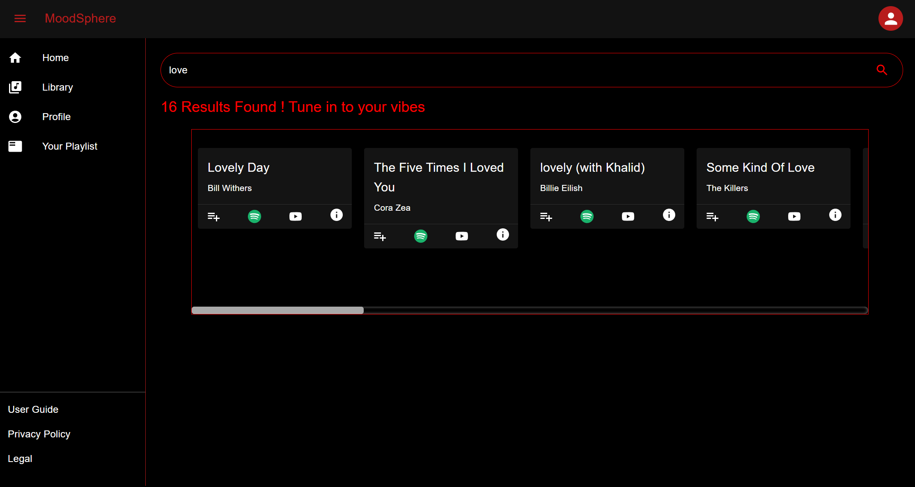
Song and Artist Search Library

Slide 94
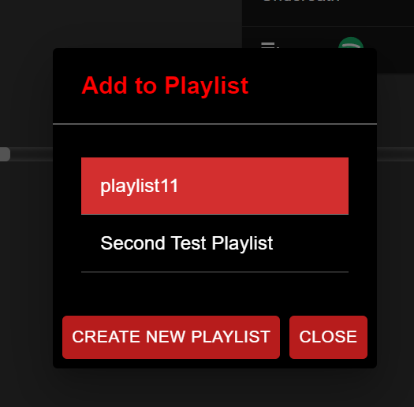
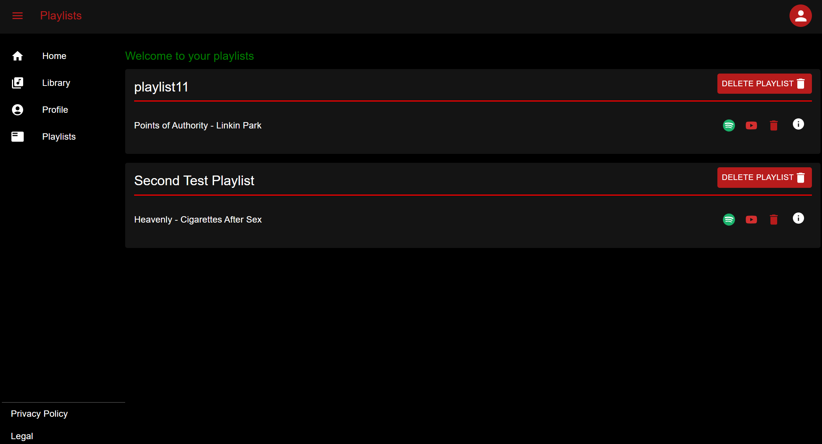
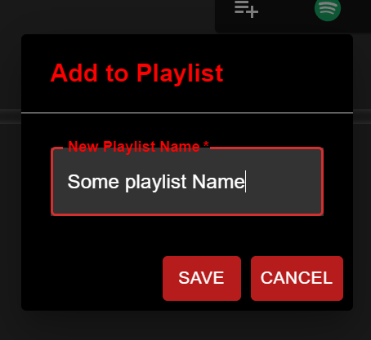
Playlist Feature
Add to Existing
Create new

Slide 95
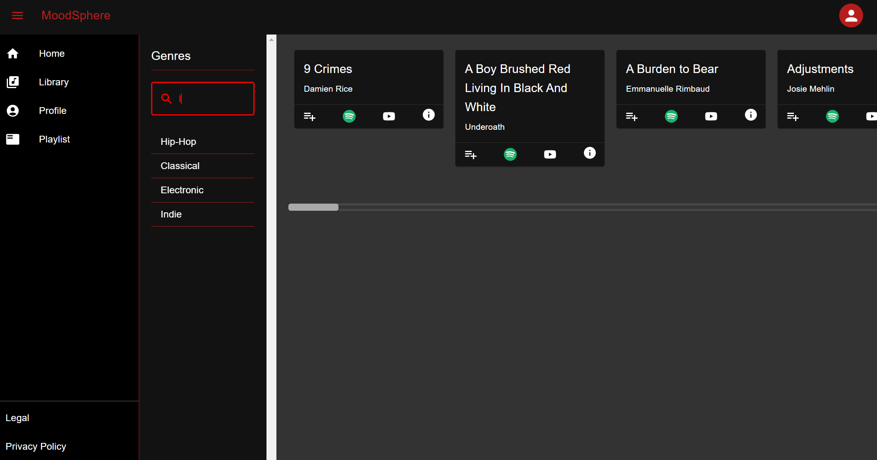
Search Songs by Genre

Slide 96
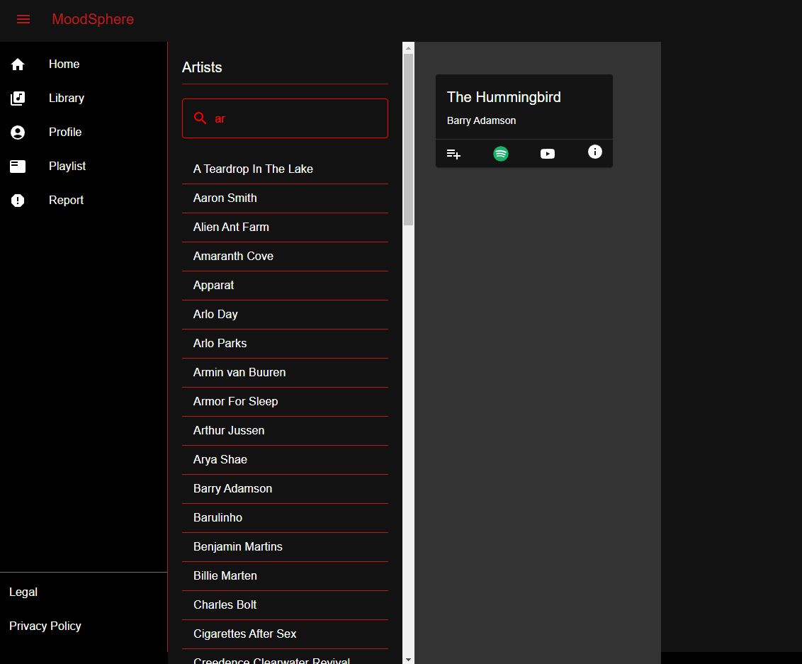
Find music by artist

Slide 97
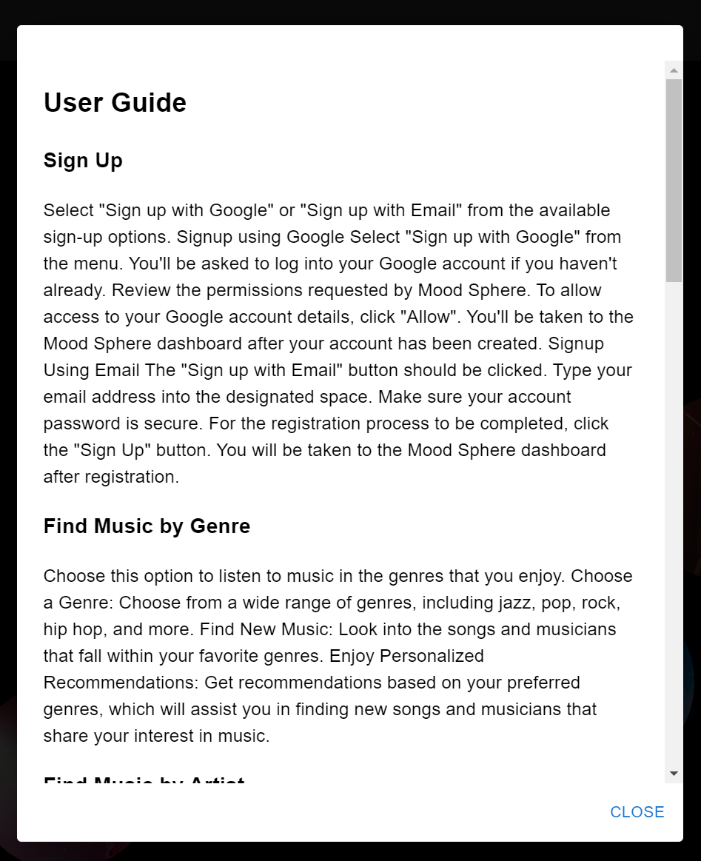
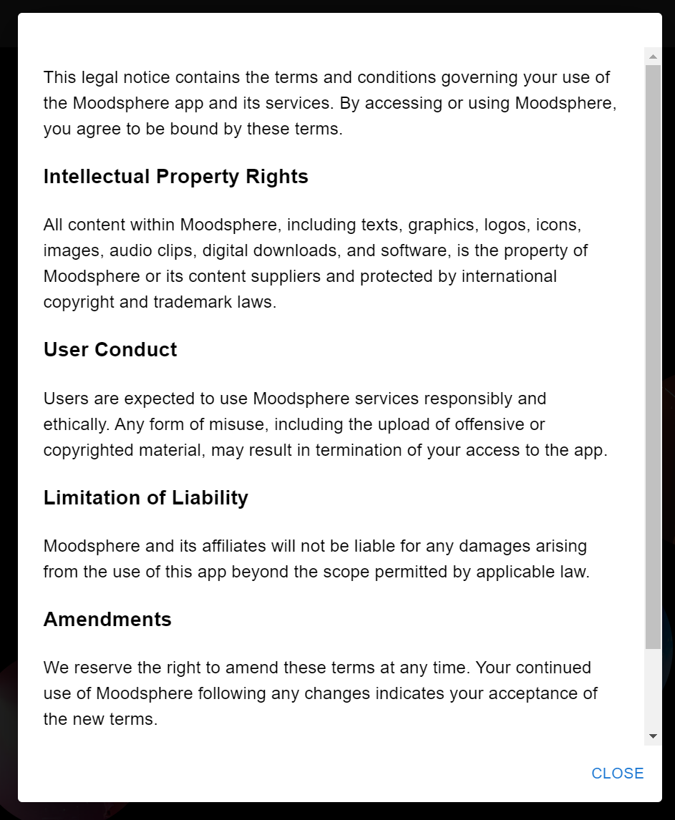
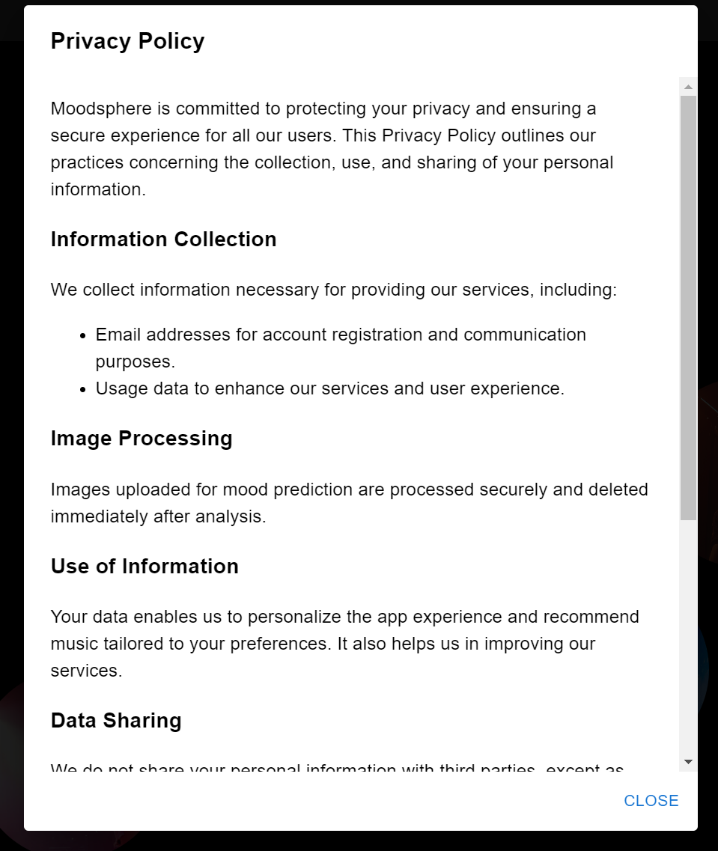
User Guide, Privacy policy and Legal Modals

Slide 98
ApI SLIDES

Slide 99
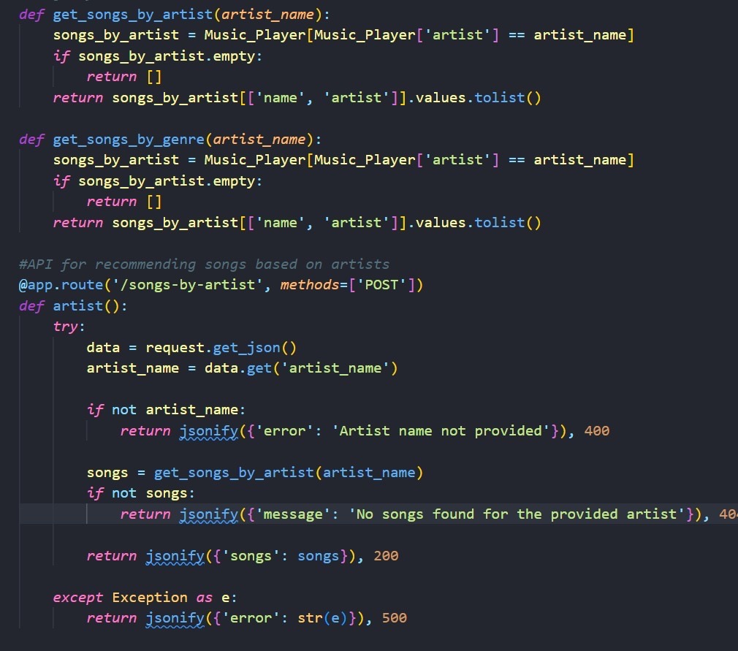
API Endpoint: /songs-by-artist
This API endpoint “/songs-by-artist” is designed to recommend songs based on a provided artist name.
The API endpoint accepts POST requests and expects to receive a JSON payload containing an artist name. It processes this input to find and return a list of songs associated with the specified artist.
Upon receiving the request, it attempts to parse the JSON to extract the artist's name.
If no artist name is provided, it responds with an error and a 400-status code. If an artist name is given, it then uses the get_songs_by_artist function to retrieve the corresponding songs

Slide 100
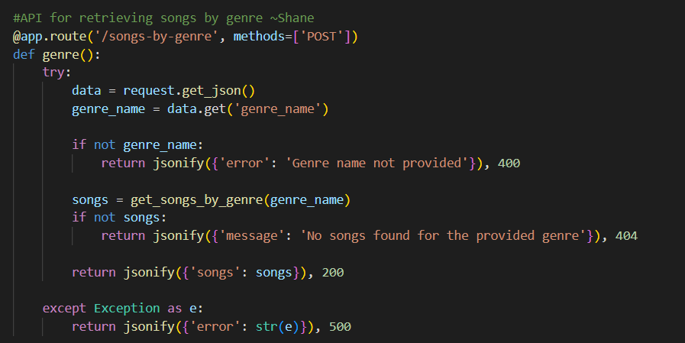
API Endpoint: /songs-by-genre
This endpoint is for handling POST requests to the URL path '/songs-by-genre'. It processes incoming JSON data to extract a 'genre_name' and uses it to retrieve songs matching that genre via the get_songs_by_genre function. The function ensures robust error handling by validating the presence of 'genre_name', checking the availability of songs, and catching exceptions. If 'genre_name' is not provided or no songs are found, it returns appropriate error messages and HTTP status codes (400 for bad input and 404 for no data found). In case of success, it returns a list of songs with a 200 status code. Any exceptions during the process result in a 500 status code, signaling an internal server error.

Slide 101
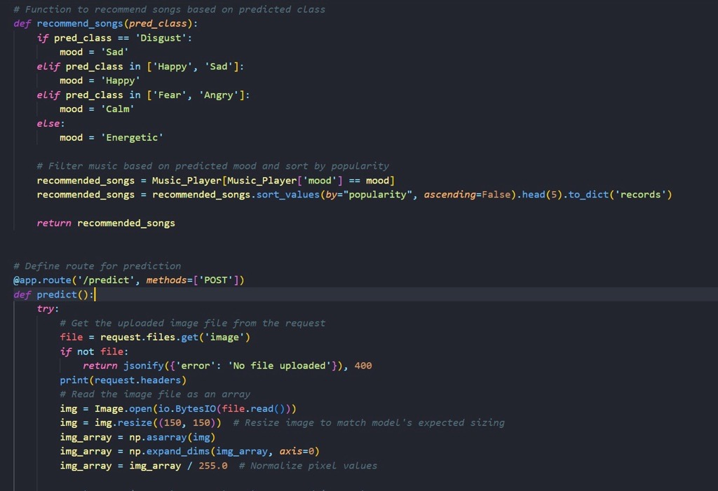
API Endpoint: /predict
The function recommend_songs takes a predicted class of mood from an image and maps it to a corresponding mood category. For example, 'Disgust' is mapped to 'Sad', and combinations like ['Happy', 'Sad'] or ['Fear', 'Angry'] are mapped to 'Happy' or 'Calm' respectively. Any other mood prediction results in the 'Energetic' category.
Once the mood is determined, the system filters the songs from the Music_Player dataset that match the mood category. Then it sorts these songs by their popularity in descending order and returns the top 5 as a dictionary in the 'records' format.

Slide 102
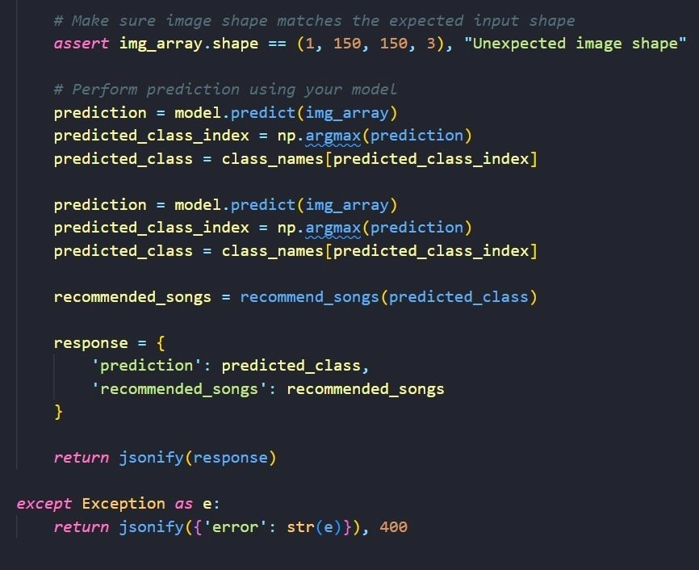
API Endpoint: /predict
Before making a prediction, the code asserts that the shape of the pre-processed image array matches the expected input shape for the model, which is (1, 150, 150, 3). If the shape does not match, an assertion error with the message "Unexpected image shape" will be raised.
The response is constructed as a JSON object with two fields: 'prediction', containing the name of the predicted mood class, and 'recommended_songs', containing the list of songs recommended by the system. This response is then returned to the client. If an exception occurs during the process, an error response with a 400-status code and the exception message is returned.

Slide 103
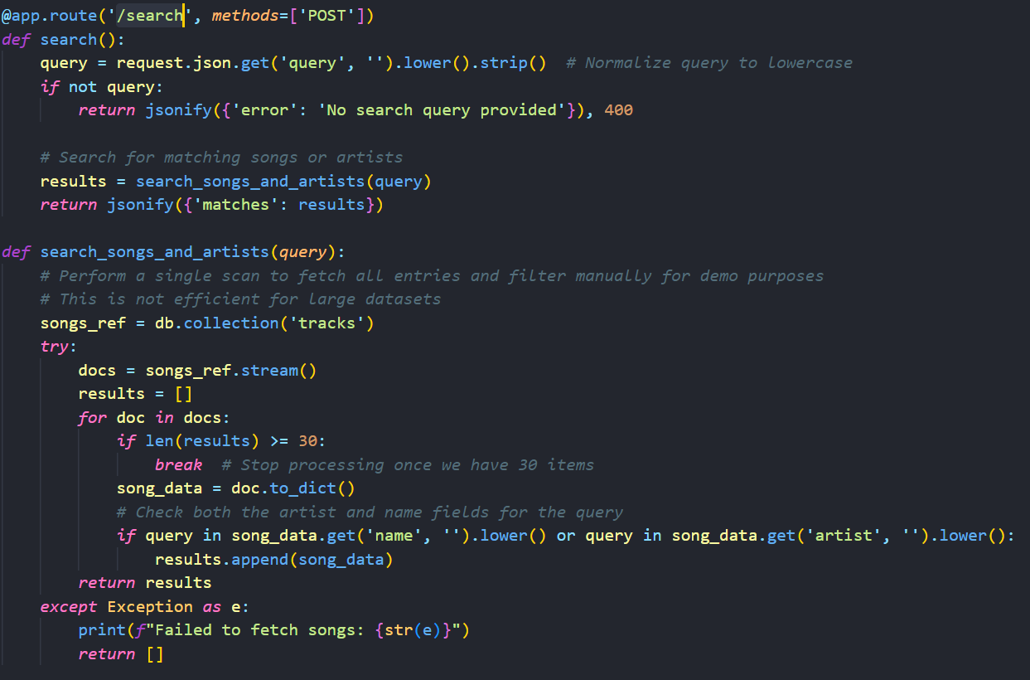
API Endpoint: /search
The /search API endpoint processes search queries for songs or artists, ensuring the 'query' string is neither empty nor just spaces. Valid queries trigger a JSON response with a 'matches' array containing relevant search results.
Upon receiving a valid request, the server responds with a JSON object containing a field named 'matches', which includes an array of search results pertinent to the user's input. In cases where the input is invalid, the server encounters a network issue, or the response structure is not as expected, the endpoint logs an error and resets the search results to an empty array.
Client-side error or status messages reflect the success or failure of the search request. The endpoint can return various status codes: 200 OK for successful retrieval of search results, 400 Bad Request for improper request formatting or missing information, and 500 Internal Server Error when server issues prevent request fulfillment. This setup ensures that the endpoint effectively enhances user interaction by promptly providing relevant music and artist search results.

Slide 104
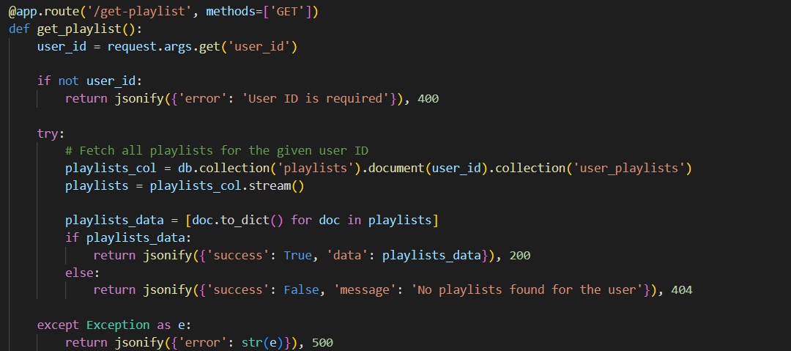
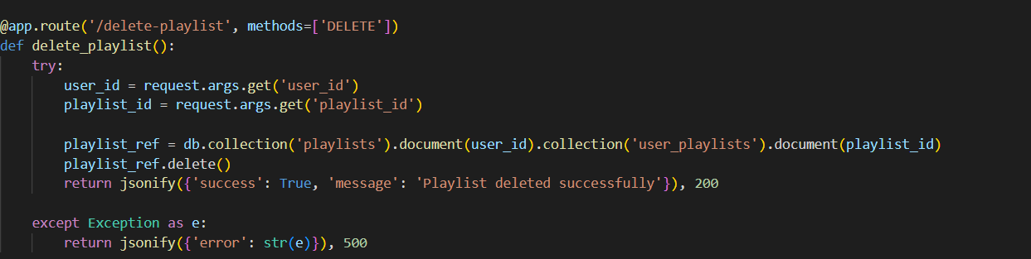
API Endpoint: /get-playlist
Method: GET
Description: Fetches all playlists associated with the logged-in user.
Parameters:
user_id: The unique identifier of the user.
Response: Returns a JSON object containing a success status and an array of playlist data if successful. On failure, it provides an error message.
Error Handling: The component logs an error and sets the playlist array to empty if the fetch fails.
API Endpoint: /delete-playlist
Method: DELETE
Description: Deletes a specific playlist.
Parameters:
user_id: The user's unique identifier.
playlist_id: The unique identifier of the playlist to be deleted.
Response: Returns a success message upon successful deletion.
Error Handling: Logs an error message if the deletion fails and refreshes the playlist data to maintain consistency.

Slide 105
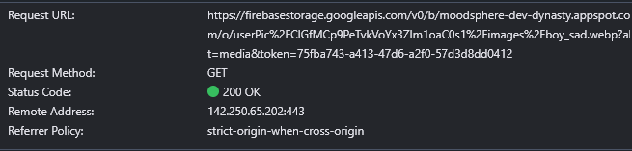
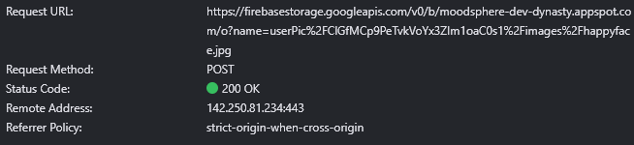
API Endpoint: userPic/${user.uid}/images
Method: GET
Description: Fetches all the user's saved images from Firestore, retrieves their download URLs from Firebase Storage, and updates the gallery UI
Parameters:
user_id: The unique identifier of the user, used to access the specific Firestore collection of the user's images
Response: Returns a JSON object containing a success status and an array of image data (including file names and download URLs) if successful. On failure, it provides an error message.
Error Handling: The function logs an error and updates the gallery UI with an empty array if the fetch fails.
API Endpoint: userPic/${user.uid}/images/${file.name}
Method: POST
Description: Uploads an image file to Firebase Storage, stores its metadata in Firestore, and updates the UI with the image preview and relevant notifications.
Parameters:
event: Contains the file selected by the user through a file input form.
Response: Returns a JSON object containing a success status and updates related UI components if successful. On failure, it provides an error message.
Error handling: Logs an error to the console and displays an error notification via toast if the upload process encounters any issues.

Slide 106
GITHUB Link https://github.com/htmw/2024S-Dev-Dynasty/wiki

Slide 107
LIVE APPLICATION DEMO LINk https://www.youtube.com/watch?v=O0ubhMgBNQg&feature=youtu.be

Slide 108

Thank you
DevDynasty

